Slide 1
NON-WSQ COURSE • C1382
Version v5.2 · 27 October 2026
Claude AI Masterclass
Threads Edition
Projects, threads, artefacts, connectors, skills and content — for marketing teams
Tertiary Infotech Academy Pte Ltd
UEN: 201200696W
www.tertiarycourses.com.sg | enquiry@tertiaryinfotech.com | +65 6100 0613
© Tertiary Infotech Academy Pte Ltd

Slide 2
1
Introductions
COURSE ADMINISTRATION
2
Ground rules
Welcome
3
Course outline
4
How today runs
© Tertiary Infotech Academy Pte Ltd
Claude AI Masterclass - Threads Edition
2

Slide 3
ICE-BREAKER
Let's Know Each Other
Take a minute to introduce yourself to the class.
Your name and role
Which team you sit in and what you are responsible for.
Your marketing work
One piece of content or report you produce again and again.
1
2
Your channels
Which social platforms and tools your team actually uses.
Your goal today
What you would most like Claude to take off your plate.
3
4
© Tertiary Infotech Academy Pte Ltd
Claude AI Masterclass - Threads Edition
3

Slide 4
INTRODUCTION
About the Trainer
✓
Qualifications: ____________________________________________
TN
✓
Expertise: _________________________________________________
[ Trainer Name ]
[ Title / Role ]
✓
Experience: ________________________________________________
✓
Contact / Profile: __________________________________________
© Tertiary Infotech Academy Pte Ltd
Claude AI Masterclass - Threads Edition
4

Slide 5

INTRODUCTION
About the Trainer
✓
PhD-qualified trainer specialising in AI, software engineering and developer tooling.
AC
✓
Hands-on experience building agentic AI applications and automations with Claude.
Dr. Alfred Ang
AI Trainer & Engineer
✓
Trains professionals across Singapore on practical, project-based AI skills.
✓
Certifications: Claude Certified Associate (Foundations), PMP, AWS, Microsoft, CompTIA, CKA, CKAD.
●
linkedin.com/in/angchewhoe
●
github.com/alfredang
© Tertiary Infotech Academy Pte Ltd
Claude AI Masterclass - Threads Edition
5

Slide 6
HOUSEKEEPING
Ground Rules
Phones on silent
Step out quietly if you need to take a call.
Ask as you go
No question is too small — others usually have the same one.
Learn by doing
Every block of theory is followed by a lab you build yourself.
Use the mock data
Never bring real customer or personal data into a training exercise.
Check before you publish
Approve every post and email against the source facts.
Mutual respect
One conversation at a time; agree to disagree.
© Tertiary Infotech Academy Pte Ltd
Claude AI Masterclass - Threads Edition
6

Slide 7
ROADMAP
Course Outline
1
2
3
Claude Projects and Market Research
Connectors, Skills and Plugins
Content Production and Scheduled Work
• The Claude family and setup
• Projects: goal, instructions, context, memory
• Lead agent and parallel threads
• Market research and Live Artefacts
• Connectors: Drive and Gmail
• Context window housekeeping
• Slides, Docs and built-in skills
• Agent Skills, plugins and mods
• One thread per channel
• Social post specs and brand checks
• Script, storyboard, render: the video pipeline
• Scheduled tasks, memory and usage
© Tertiary Infotech Academy Pte Ltd
Claude AI Masterclass - Threads Edition
7

Slide 8
WHAT YOU'LL ACHIEVE
Learning Outcomes
1
Set up the Project
Set up a Claude Project with a goal, instructions, context and memory, and explain how its lead agent splits work into parallel threads.
2
Research in threads
Run multi-subject market research as parallel threads and consolidate it into one verified research brief.
3
Build a Live Artefact
Build, refine, save and download a Live Artefact dashboard from supplied research data.
4
Connect Drive and Gmail
Connect Google Drive and Gmail so Claude reads campaign files and sends an approved summary.
5
Slides and Docs
Produce a launch deck and a campaign brief with Claude's Slides and Docs, using built-in skills.
6
Skills and plugins
Capture a brand voice as an Agent Skill with /skill-creator, and install and use a marketing plugin.
7
Social posts in threads
Create a two-week, multi-platform set of social media posts in parallel threads using the brand-voice skill.
8
Make a launch video
Produce a short vertical launch video from a script, storyboard and supplied brand assets.
9
Schedule and review
Schedule recurring project tasks, maintain project memory and review thread usage, keeping a human approval step.
© Tertiary Infotech Academy Pte Ltd
Claude AI Masterclass - Threads Edition
8

Slide 9
SCHEDULE
Lesson Plan — One Day
9:00am – 6:00pm, with a one-hour lunch and two tea breaks.
Morning
Afternoon
• 9:00 Welcome
• 9:20 Topic 1 — Claude Projects and Market Research
• 9:55 Hands-on: Lab 1
• 10:20 Tea break
• 10:35 Hands-on: Lab 2
• 11:15 Topic 1 — Live Artefacts
• 11:25 Hands-on: Lab 3
• 12:05 Topic 2 — Connectors, Skills and Plugins
• 12:30 Lunch break
• 13:30 Hands-on: Lab 4
• 14:05 Topic 2 — Slides, Docs and Agent Skills
• 14:15 Hands-on: Lab 5
• 14:45 Hands-on: Lab 6
• 15:15 Tea break
• 15:30 Topic 2 — Plugins and mods
• 15:40 Hands-on: Lab 7
• 16:05 Topic 3 — Content Production and Scheduled Work
• 16:15 Hands-on: Lab 8
• 16:55 Hands-on: Lab 9
• 17:25 Hands-on: Lab 10
• 17:45 Recap
© Tertiary Infotech Academy Pte Ltd
Claude AI Masterclass - Threads Edition
9

Slide 10
LEARNING APPROACH
How You'll Learn
1
2
3
4
5
Watch
▶
Build
▶
Check
▶
Discuss
▶
Reuse
The trainer demonstrates the technique live.
You build it yourself in the hands-on lab.
Verify your output against the lab's check step.
We troubleshoot together as a class.
Take the artefact and the prompt back to your own work.
Ten labs, one continuous scenario — each lab builds on the one before it.
© Tertiary Infotech Academy Pte Ltd
Claude AI Masterclass - Threads Edition
10

Slide 11
BEFORE WE START
Your Course Materials
Open the prompts page now — you will paste from it in every lab.
Copy-ready prompts
https://tertiarycourses.github.io/C1382-Claude-AI-Masterclass/prompts/threads/ — every lab's prompt with a copy button. Keep it open in a browser tab all day.
1
Lab files and data
https://github.com/tertiarycourses/C1382-Claude-AI-Masterclass — each lab folder holds its prompt PDF and, where needed, a data folder of mock files.
2
Your Learner Guide
The full step-by-step for every lab, the reason for each step, and the check to run at the end.
3
© Tertiary Infotech Academy Pte Ltd
Claude AI Masterclass - Threads Edition
11

Slide 12
THE SCENARIO
The Lumo Cold Kopi launch
It is late October 2026. Lumo Kopi Co. launches Lumo Cold Kopi, its first ready-to-drink canned kopi, in Singapore on 1 December — six weeks away — and in Kuala Lumpur in January. The marketing team is small, the budget is S$60,000, and nothing has been produced yet: no research, no deck, no posts, no video.
© Tertiary Infotech Academy Pte Ltd
Claude AI Masterclass - Threads Edition
12

Slide 13
THE SCENARIO
One Brand, Ten Labs, One Project
Your role
You are the Lumo marketing team. Instead of juggling a dozen separate chats, you run the whole launch from one Claude Project. Its lead agent plans each job, starts parallel threads for the pieces, and brings the results back for you to check and approve.
Your mission
By the end of the day the project holds everything the launch needs — verified market research, a dashboard, a deck and brief, a brand-voice skill, two weeks of social posts, a launch video — and scheduled tasks that keep it moving while you are away.
Synthetic data only
All brands, figures, survey answers and documents in this course are synthetic and used for training only.
© Tertiary Infotech Academy Pte Ltd
Claude AI Masterclass - Threads Edition
13

Slide 14
TOPIC 01
1
The Claude family and setup
Claude Projects and Market Research
2
Projects: goal, instructions, context, memory
3
Lead agent and parallel threads
4
Market research and Live Artefacts
© Tertiary Infotech Academy Pte Ltd
Claude AI Masterclass - Threads Edition
14

Slide 15
TOPIC 1 · OVERVIEW
The Claude Product Family
Anthropic offers several Claude products — here's how they differ so you know which is which.
C
Co
D
Claude (Chat + Cowork)
Claude Code
Claude Design
Chat + Cowork in one app — web, desktop & mobile.
The agentic tool for building — terminal, IDE & web.
Polished UI, prototypes & front-end designs.
M
Ch
S
Claude for Microsoft
Claude for Chrome
Claude for Science
Claude inside Excel, PowerPoint, Word & Outlook.
Browser agent that clicks & fills forms in Chrome.
Speeds up research workflows for scientists and labs.
TIP All are powered by the same Claude models — they differ in where they run and who they're for. Projects span Claude and Claude Code.
© Tertiary Infotech Academy Pte Ltd
Claude AI Masterclass - Threads Edition
15

Slide 16
TOPIC 1 · OVERVIEW
Claude (Chat + Cowork) and Claude Code
C
Co
Claude (Chat + Cowork)
Claude Code
“Thinking and work partner — this course”
“Build partner”
Best for
Best for
• Chat: ask, draft, analyse and research with web search
• Cowork: plans and runs multi-step tasks on your files
• Projects, connectors and skills: Drive, Gmail, Calendar
• For everyone — web, desktop and mobile apps
• Builds software, sites and automations
• Runs in the terminal, VS Code, desktop app and web
• Edits files, runs commands and calls MCP tools
• Extended with CLAUDE.md, skills, sub agents and hooks
Chat and Cowork are now one app: Claude. A marketing team works there — and a Project ties the work together around one goal.
© Tertiary Infotech Academy Pte Ltd
Claude AI Masterclass - Threads Edition
16

Slide 17
TOPIC 1 · OVERVIEW
A Brief History of AI, 2023–2026
Prompt Engineering
Context Engineering
Harness Engineering
AI Agents
2023
2024
2025
2026
ChatGPT goes mainstream; results depend on the prompt wording.
Models call tools and MCP launches; results depend on context.
Claude Code & Codex: systems that plan, act and check their work.
Always-on agents work 24/7 — OpenClaw, Hermes Agent, agent teams.
From wording one prompt → curating context → engineering the harness → AI agents that work around the clock.
© Tertiary Infotech Academy Pte Ltd
Claude AI Masterclass - Threads Edition
17

Slide 18
TOPIC 1 · OVERVIEW
What Cowork Mode Adds
Five things a chat window cannot do.
Access local files
Read, write and reorganise the folders on your computer.
Write & run code
It writes the code a task needs — a chart, a video — and runs it for you.
1
2
Connect to tools
Reach Google Drive, Gmail and Calendar through connectors.
Skills & plugins
Reusable instructions it loads on demand, shareable with your team.
3
4
Agent loop
Plan, act, check, correct — it keeps working until the task is done.
5
Together these are why Claude finishes a task instead of describing how to do it.
© Tertiary Infotech Academy Pte Ltd
Claude AI Masterclass - Threads Edition
18

Slide 19
TOPIC 1 · SETUP
Claude Plans and Pricing
Free lets you try Claude; Cowork, scheduled tasks and full Projects need Pro or Max.
F
P
M
T
Free
Pro
Max
Team · Enterprise
$0. Chat, Slides, Docs, connectors and skills, up to five projects. Sonnet and Haiku.
$17/mo billed annually · $20 monthly. Cowork, scheduled tasks, the new Projects (beta), Opus.
From $100/mo — 5× or 20× Pro's usage, priority at busy times, $100–$200/mo API credits.
Team $20/seat annual ($25 monthly), premium seats $100. Enterprise $20/seat + usage.
Parallel threads multiply usage: four threads cost roughly four times one chat. Watch Project settings → Usage.
TIP Usage resets every five hours, with weekly limits on paid plans. US$ prices as of 27 October 2026 — verify at claude.com/pricing.
© Tertiary Infotech Academy Pte Ltd
Claude AI Masterclass - Threads Edition
19

Slide 20
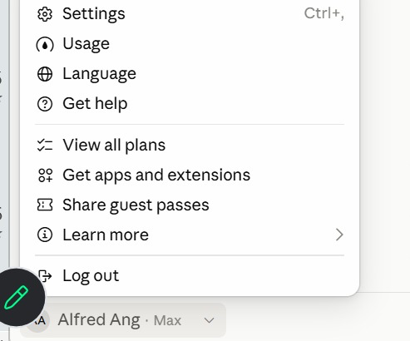
TOPIC 1 · IN THE APP
Check Your Plan and Usage
1
Usage
How much of your five-hour and weekly limits you have used.
2
View all plans
Compare Free, Pro, Max, Team and Enterprise, and upgrade.
3
Settings
Your profile, connectors and capabilities. Shortcut: Ctrl + comma.
Click your name at the bottom of the sidebar — the plan shows beside it (here, Max).
© Tertiary Infotech Academy Pte Ltd
Claude AI Masterclass - Threads Edition
20

Slide 21
TOPIC 1 · SETUP
Claude Models: Haiku, Sonnet, Opus and Fable
Four families, smallest to most capable; all read up to 1M tokens. API prices are US$ per million tokens, input · output.
Model
What it is
Use it for
API price
On plans
Haiku 5.5
Fastest, most cost-efficient
Quick, high-volume jobs: tagging, short replies
$0.10 / $0.50
All plans
Sonnet 5.5
High performance for coding and agents
Everyday drafting, research and analysis
$2 / $10
All plans
Opus 5.5
Daily driver for agentic and enterprise work
Multi-step projects, parallel work, careful reviews
$4 / $20
Pro and above
Fable 5.1
Most capable, for long-running agents
The hardest, longest jobs
$10 / $50
Max; Pro via usage credits
Pick the model from the model menu. Bigger models think harder and use more of your plan — save Fable for the jobs that need it.
© Tertiary Infotech Academy Pte Ltd
Claude AI Masterclass - Threads Edition
21

Slide 22
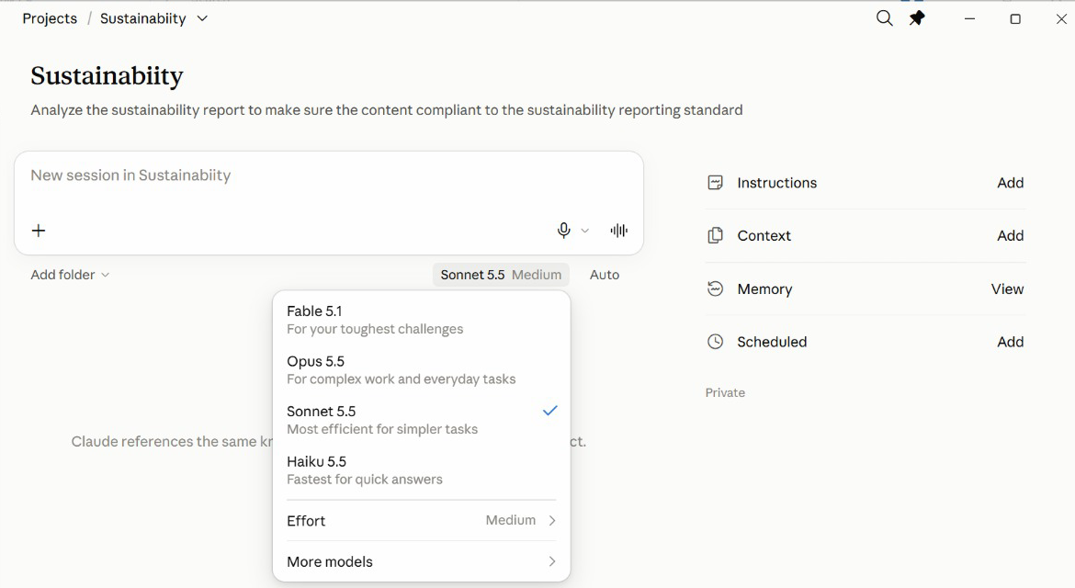
TOPIC 1 · IN THE APP
Pick a Model in the App
1
Fable 5.1
For your toughest challenges — uses the most of your plan.
2
Opus 5.5
Complex work and everyday tasks.
3
Sonnet 5.5
Efficient for most jobs — a sensible default.
4
Haiku 5.5
Fastest, for quick answers.
The model menu sits under the message box of every new session.
© Tertiary Infotech Academy Pte Ltd
Claude AI Masterclass - Threads Edition
22

Slide 23
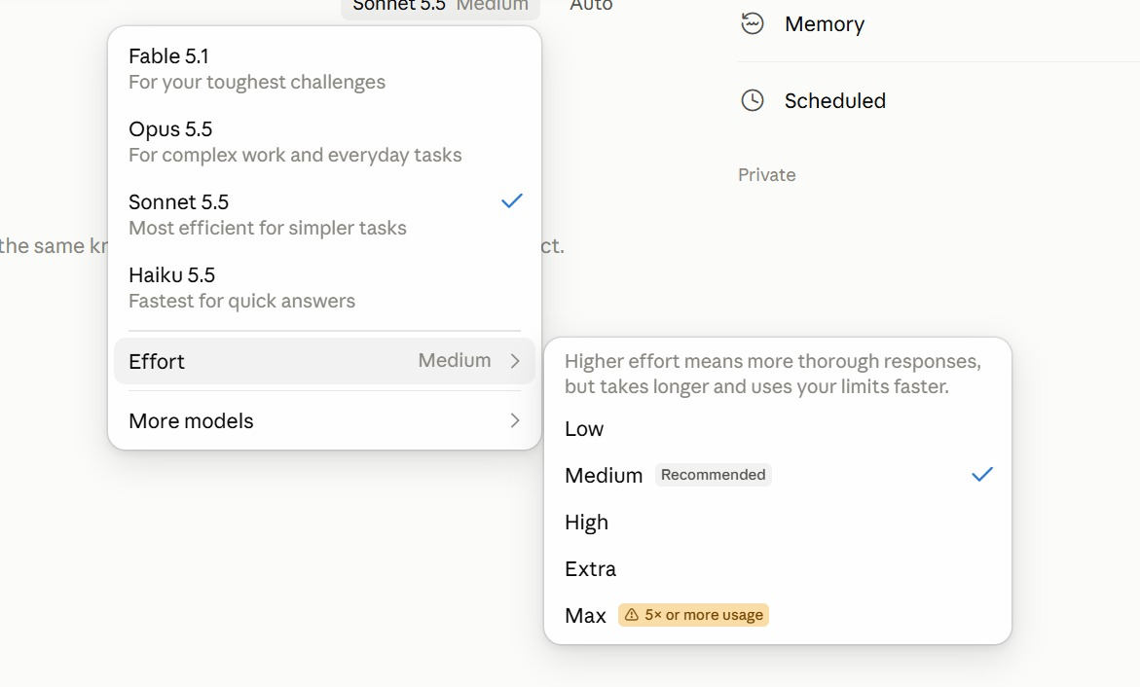
TOPIC 1 · IN THE APP
Effort: How Hard Claude Thinks
1
Low · Medium
Quick, everyday work. Medium is the recommended default.
2
High · Extra
Harder problems: more thorough, but slower and uses your limits faster.
3
Max
Five times or more the usage — save it for the hardest job.
Model menu → Effort. Medium is recommended for most work.
© Tertiary Infotech Academy Pte Ltd
Claude AI Masterclass - Threads Edition
23

Slide 24
TOPIC 1 · SETUP
Set Up Claude
Projects, Cowork mode and Live Artefacts run in the Claude desktop app on a paid plan.
Install the desktop app
Download Claude for Mac or Windows from claude.ai/download — Projects, Cowork and Live Artefacts all run there.
Sign in on a paid plan
Use the account that has your Pro or Max subscription — the new Projects are in beta on those plans.
1
2
Find Projects
Open Projects from the sidebar. If you cannot see it yet, the beta has not reached your account — use Cowork mode instead.
Download the lab files
Get the course labs from the GitHub repository; each lab has a prompt PDF and a data folder.
3
4
Enable what it needs
Turn on only the connectors a lab needs, from the + menu.
Keep the app open
Local work stops when the app closes. Cloud environments keep going — covered in Topic 3.
5
6
© Tertiary Infotech Academy Pte Ltd
Claude AI Masterclass - Threads Edition
24

Slide 25
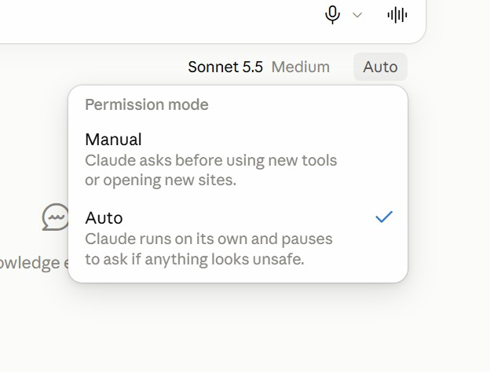
TOPIC 1 · IN THE APP
Permission Mode: Manual or Auto
1
Manual
Claude asks before it uses a new tool or opens a new site.
2
Auto
Claude runs on its own and pauses to ask only if something looks unsafe.
3
Which to use
Manual while you learn a new connector; Auto once you trust the job.
The menu beside the model sets how freely Claude acts in a session.
© Tertiary Infotech Academy Pte Ltd
Claude AI Masterclass - Threads Edition
25

Slide 26
TOPIC 1 · PROJECTS
The New Claude Projects
You stop managing chats and start briefing a team.
Before — one chat per job
Now — a Project with a lead agent
• A chat for copy, one for visuals, one for competitors.
• Re-explain the brand in every new chat.
• Copy and paste results between chats yourself.
• Nothing happens while your laptop is closed.
• You are the project manager.
• You state the goal once, to the lead agent.
• It splits the work and starts parallel threads.
• Each thread reports back; the lead merges the results.
• Goal, memory and context persist across every thread.
• It only comes back to you when it needs a decision.
© Tertiary Infotech Academy Pte Ltd
Claude AI Masterclass - Threads Edition
26

Slide 27
TOPIC 1 · PROJECTS
Project vs Session
The project is the room; a session is one working day in it.
A session — one piece of work
A project — the whole goal
• One conversation with Claude: a chat, or a thread the lead agent starts.
• Has its own context window, which fills up as you work.
• Ends when the job is done; the next session starts blank.
• Remembers only what was said inside it.
• Lumo: “Draft the Instagram launch post.”
• A lasting workspace that holds many sessions.
• Its goal, instructions, context and memory load into every session.
• Stays until you delete it — for weeks or months.
• What one session learns, the next can use, through memory.
• Lumo: “Lumo Cold Kopi Launch.”
© Tertiary Infotech Academy Pte Ltd
Claude AI Masterclass - Threads Edition
27

Slide 28
TOPIC 1 · PROJECTS
Project, Session, Thread and Agent
Claude Project
You
Lead agent
Key
Brief the goal;
approve decisions
◀ ▶
Your session: it plans,
splits and merges
Session = one conversation
Thread = a session for one job
Agent = the Claude doing it
Thread 1
Thread 2
Thread 3
Thread 4
Competitors
agent · own session
Customer survey
agent · own session
Pricing
agent · own session
Social trends
agent · own session
Shared by every session: goal · instructions · context · memory
Each thread has its own agent and context window. The lead agent merges what they return into one answer for you.
© Tertiary Infotech Academy Pte Ltd
Claude AI Masterclass - Threads Edition
28

Slide 29
TOPIC 1 · LEAD AGENT AND THREADS
A Project Is a Team
Claude Project
One goal, one lead agent, many threads
Lead agent
Thread 1
Thread 2
Plans, splits
and merges
Competitors
Customer
survey
Thread 3
Thread 4
Memory
Pricing
Social
trends
Shared by
every thread
You talk to the lead agent. It decides how many threads a job needs, gives each a focused brief, and brings one merged answer back to you.
© Tertiary Infotech Academy Pte Ltd
Claude AI Masterclass - Threads Edition
29

Slide 30
TOPIC 1 · PROJECTS
A Project Answers Four Questions
Set these up once and every session in the project starts from them.
Instructions → HOW
How Claude must work: brand voice, prices in S$, ask before sending — rules every session follows.
Context → WHAT
What Claude needs to know: brand guidelines, product sheet, launch brief — read, never edited.
1
2
Folder → WHERE
Where Claude works and saves: the project files on your computer, or a cloud environment.
Scheduled → WHEN
When work runs without you: Monday 9am the week's post drafts, Friday the weekly report.
3
4
The goal says WHY; memory keeps what each session learns for the next.
© Tertiary Infotech Academy Pte Ltd
Claude AI Masterclass - Threads Edition
30

Slide 31
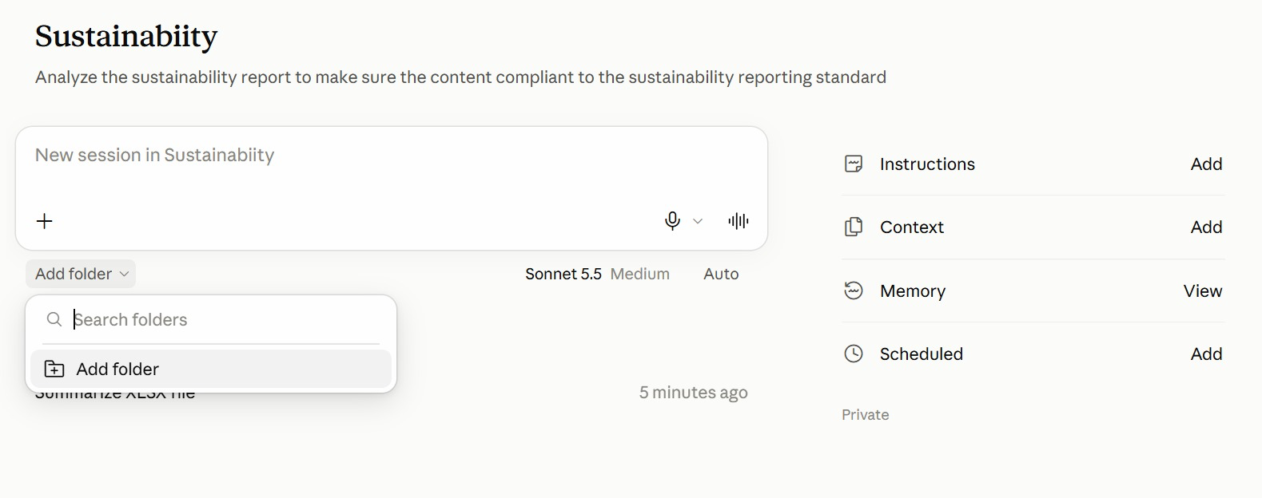
TOPIC 1 · IN THE APP
The Project Page in the App
1
Instructions · Context
HOW and WHAT — click Add to write the rules or attach reference files.
2
Add folder
WHERE — under the message box, pick the folder Claude reads from and saves to.
3
Memory · Scheduled
What Claude has learned about the project, and WHEN tasks run on their own.
4
New session
Type in the box to start a session; earlier sessions are listed beneath it.
A project from the class: the goal under its name, the project's panels on the right.
© Tertiary Infotech Academy Pte Ltd
Claude AI Masterclass - Threads Edition
31

Slide 32
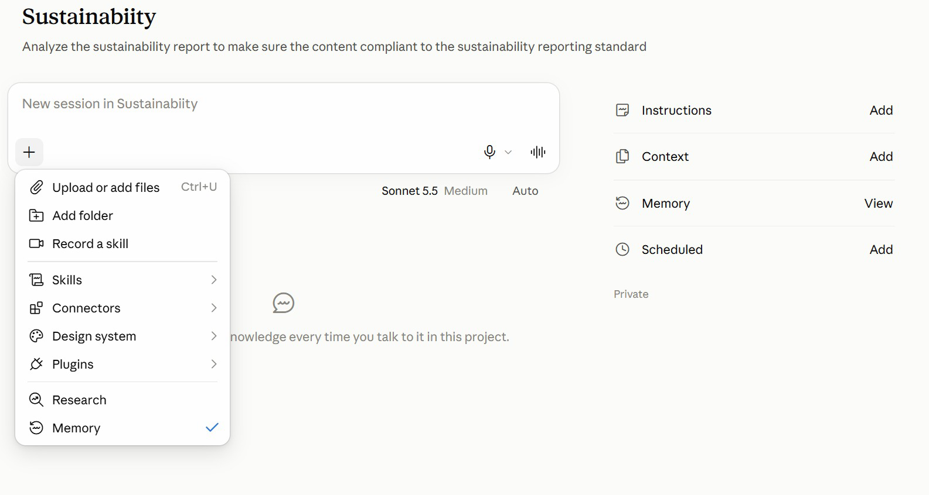
TOPIC 1 · IN THE APP
The + Menu: What a Session Can Use
1
Files and folders
Upload a file, or add a folder, for this session.
2
Skills · Connectors · Plugins
Choose what the session may use — the brand-voice skill, Gmail, a plugin.
3
Record a skill
Capture a routine you show Claude as a new skill.
4
Research · Memory
Deeper web research; the tick shows the session uses project memory.
Click + in the message box to bring files and tools into the session.
© Tertiary Infotech Academy Pte Ltd
Claude AI Masterclass - Threads Edition
32

Slide 33
TOPIC 1 · PROJECTS
When to Use a Project
A long-running goal
Work keeps arriving for weeks — a product launch, a channel, an app.
A job that splits
One big job breaks into pieces that can run at once — assets, ads, competitors, email.
1
2
Lots of research
Many subjects to look into — one thread per competitor, market or segment.
Regular check-ins
You want to review each workstream's progress, not one long chat.
3
4
A one-off question that is done in one reply? Use an ordinary chat.
© Tertiary Infotech Academy Pte Ltd
Claude AI Masterclass - Threads Edition
33

Slide 34
TOPIC 1 · PROJECTS
Anatomy of a Project
Six parts — the first four you set up in Lab 1, the last two run the work.
Goal
What the project must achieve. The lead agent steers every decision toward it.
Instructions
Standing rules you write: brand voice, currency, never publish without approval.
1
2
Context
What Claude reads: files, folders, a Google Drive folder or a GitHub repository.
Memory
What the project learns and keeps between threads. Open the memory files to edit them.
3
4
Threads
The parallel workers the lead agent starts for each piece of a job.
Scheduled
Tasks that run on a timetable inside the project — the daily post, the weekly report.
5
6
© Tertiary Infotech Academy Pte Ltd
Claude AI Masterclass - Threads Edition
34

Slide 35
TOPIC 1 · PROJECTS
Creating a Project, Field by Field
New project opens the Create a project dialog.
Name
What you are working on — Lumo Cold Kopi Launch. This is how you find it in the sidebar.
1
Goal
What the project must achieve, in two or three sentences. You can type it or dictate it.
2
Context
Add the brand kit files now, or a folder or Drive folder. You can skip and add them later.
3
Create project
The lead agent opens, reads the goal and context, and is ready for its first job.
4
New project is at the top right of the Projects page. Instructions and memory are edited afterwards, in Project settings.
© Tertiary Infotech Academy Pte Ltd
Claude AI Masterclass - Threads Edition
35

Slide 36
TOPIC 1 · PROJECTS
Project Settings
1
General
The project name, the goal, and the models and effort for the lead agent and the threads.
2
Memory
The project instructions and the memory files the project has written — open one to edit it.
3
Environment
Local, or a cloud environment so threads keep working with your laptop closed.
4
Usage
Input and output tokens, for the lead agent and for each thread separately.
5
Debug access
Let another project read this one's conversations, read-only, to help diagnose a problem.
Open Project settings from the gear icon at the top right of the project.
© Tertiary Infotech Academy Pte Ltd
Claude AI Masterclass - Threads Edition
36

Slide 37
TOPIC 1 · PROJECT SETTINGS
Models and Effort
The lead agent and the threads each have their own model and effort.
Role
Typical default
Effort
Change it when
Lead agent
Opus 5.5
Low
It misreads your requests — raise to Medium.
Threads
Opus 5.5
Medium
Research is shallow — raise; drafts are simple — lower.
Effort
—
Low · Medium · High
Higher effort thinks harder and uses more of your limit.
Defaults vary by account and change over time — read yours in Project settings → General → Models.
© Tertiary Infotech Academy Pte Ltd
Claude AI Masterclass - Threads Edition
37

Slide 38
TOPIC 1 · PROJECTS
Instructions vs Context
Quick test: a sentence that starts Always, Never or Write in… is an instruction. A document is context.
Instructions — how to behave
Context — what to know
• Short standing rules you write yourself.
• Followed by every session in the project.
• Like the house rules pinned on the office wall.
• Keep them short: they are loaded into every session.
• Lumo: “Prices in S$. No health claims. Ask before sending.”
• Reference material Claude reads but never edits.
• Files, a folder, a Google Drive folder or a GitHub repository.
• Like the reference binders on the office shelf.
• Add it once; you never re-attach it again.
• Lumo: brand guidelines, product sheet, launch brief.
© Tertiary Infotech Academy Pte Ltd
Claude AI Masterclass - Threads Edition
38

Slide 39
TOPIC 1 · PROJECTS
Instructions, Context or Memory?
When the output is wrong, this tells you which one to edit.
Instructions
Context
Memory
Who writes it
You
You add it
The project, as it works
What it holds
Rules and style
Files and folders to read
Facts and decisions learned
Lumo example
Prices in S$; no health claims
Brand guidelines, launch brief
Launch date moved; IG performs best
Edit it in
Settings → Memory
Context panel
Settings → Memory → memory files
When output is wrong
Tighten the rule
Add the missing file
Correct or delete the fact
© Tertiary Infotech Academy Pte Ltd
Claude AI Masterclass - Threads Edition
39

Slide 40
TOPIC 1 · PROJECTS
An Analogy: The Project Room
Picture the project as a room your team works in for the whole launch.
In Claude
In the office
What it means
Lumo example
Project
The project room
Stays set up for weeks
Lumo Cold Kopi Launch
Session
One working day in the room
Starts fresh; the room is still set up
Draft the Instagram post
Lead agent
The team lead
Splits the job, merges the results
Four research threads, one brief
Instructions
House rules on the wall
How every session must behave
Prices in S$; no health claims
Context
Binders on the shelf
What Claude reads, never edits
Brand guidelines, product sheet
Memory
The team logbook
Decisions kept between sessions
Launch price confirmed at S$3.90
Scheduled
The room's recurring calendar
Work that runs on a timetable
Monday 9am: the week's posts
© Tertiary Infotech Academy Pte Ltd
Claude AI Masterclass - Threads Edition
40

Slide 41
TOPIC 1 · PROJECTS
Why a Project?
A dedicated place for ongoing work, where context builds over time.
Working in one-off chats
Working in a Claude Project
• You re-attach the brand kit every session.
• Rules are restated from memory each time.
• Research, posts and artefacts are scattered.
• A colleague has to be told how you set it up.
• Work stops when you stop typing.
• Context is added once and read by every thread.
• Instructions apply to every job in the project.
• Artefacts, skills and outputs live together.
• A colleague opens the project and is ready.
• Scheduled tasks run while you are away.
© Tertiary Infotech Academy Pte Ltd
Claude AI Masterclass - Threads Edition
41

Slide 42
TOPIC 01 · KEY CONCEPTS
Key Concepts — Claude Projects and Market Research
Claude Project
A home for a long-running goal. Context, memory and work build up over time instead of resetting each chat.
Lead agent
The project's coordinator. You tell it the goal; it plans, splits the work and reports back.
1
2
Threads
Parallel workers the lead agent starts — one per subject — each with its own focused context.
Goal
One clear statement of what the project must achieve. Every decision the lead agent makes points at it.
3
4
Instructions vs memory
Instructions are the rules you write. Memory is what the project learns and keeps — and you can edit it.
Live Artefacts
Interactive tools — dashboards, trackers — that persist in your workspace instead of scrolling away in chat.
5
6
© Tertiary Infotech Academy Pte Ltd
Claude AI Masterclass - Threads Edition
42

Slide 43
LAB 01 · HANDS-ON
Set Up the Lumo Launch Project
LAB 01
Objective: Create a Claude Project with a goal, instructions, context and memory
Lumo Kopi Co. launches Lumo Cold Kopi in six weeks, and the marketing work will keep coming until launch day — exactly what a Claude Project is for. You create the Lumo Cold Kopi Launch project, give it a goal, add the brand kit as context, write its standing instructions, and check that its lead agent understood all three. Every later lab runs inside this project.
YOU'LL BUILD
The Lumo Cold Kopi Launch project, with a goal, instructions, three context files and a first memory entry.
Tools: Claude desktop app, Claude Projects
© Tertiary Infotech Academy Pte Ltd
Claude AI Masterclass - Threads Edition
43

Slide 44
LAB 01 · IN THE PROJECT
Lab 01 in the Project
What this lab sets up, uses, adds or schedules in the project.
Instructions → HOW
Set up: paste Block 2 into Project settings → Memory — S$ prices, brand guidelines, no health claims, approval first.
Context → WHAT
Set up: add the brand kit — guidelines, product sheet and launch brief.
1
2
Folder → WHERE
Outputs are saved in the project. Local by default; Topic 3 adds a cloud environment.
Scheduled → WHEN
Not yet — Lab 8 adds the first scheduled task.
3
4
© Tertiary Infotech Academy Pte Ltd
Claude AI Masterclass - Threads Edition
44

Slide 45
LAB 01 · THE PROMPT · STEP 3
Block 1 — GOAL
PROMPT — copy into Claude
Launch Lumo Cold Kopi in Singapore on 1 December 2026.
Produce the market research, a launch deck, a campaign brief,
two weeks of social media posts and a 15-second launch video,
within a S$60,000 budget, so that 25-34 year-olds on Instagram
and TikTok know the product exists by launch day.
NOTE Name: Lumo Cold Kopi Launch. Add the three brand-kit files as Context.
© Tertiary Infotech Academy Pte Ltd
Claude AI Masterclass - Threads Edition
45

Slide 46
LAB 01 · THE PROMPT · STEP 5
Block 2 — INSTRUCTIONS
PROMPT — copy into Claude
You are the marketing team for Lumo Kopi Co.
- Prices are in Singapore dollars: S$3.90 per can, S$42.00 per
12-pack. Always two decimals.
- Follow lumo-brand-guidelines.md for anything customer-facing.
- Never describe the product as healthy. You may say 5 g sugar.
- Never send an email or publish a post without my approval.
- When a job has several independent subjects, give each one
its own thread and merge the results for me.
- Flag any figure that two sources disagree on. Do not pick one.
NOTE Save the instructions before you send Block 3.
© Tertiary Infotech Academy Pte Ltd
Claude AI Masterclass - Threads Edition
46

Slide 47
LAB 01 · THE PROMPT · STEP 7
Block 3 — FIRST MESSAGE
PROMPT — copy into Claude
Before we start work, check your setup:
1. Restate the project goal in one line.
2. List the context files you can read and what each is for.
3. List the three instructions you think matter most.
4. From the product sheet, give me the price per can, the sugar
per can and the launch date.
Then remember this for the project: our primary audience is
25-34 year-olds in Singapore, and our secondary market is
Kuala Lumpur, launching 15 January 2027.
NOTE Check the four answers, then find the new entry in the memory files.
© Tertiary Infotech Academy Pte Ltd
Claude AI Masterclass - Threads Edition
47

Slide 48
LAB 01 · STEPS
Set Up the Lumo Launch Project
Full step-by-step, with the reasoning for each step, is in your Learner Guide.
Download the course labs and open the Lab 01 data/brand-kit folder.
While you are in settings, open General and look at Models.
1
6
In the Claude desktop app, open Projects from the sidebar and click New project.
Back in the project, send Block 3 to the lead agent.
2
7
Name the project Lumo Cold Kopi Launch and paste Block 1 into the Goal field.
Check the answers: S$3.90 per can, 5 g sugar, launch 1 December 2026.
3
8
Under Context, add the three brand-kit files, then click Create project.
Open Project settings → Memory and find the memory entry about the audience and Kuala Lumpur.
4
9
Click the gear icon to open Project settings, choose Memory, and paste Block 2 into Project instructions. Save.
5
© Tertiary Infotech Academy Pte Ltd
Claude AI Masterclass - Threads Edition
48

Slide 49
LAB 01 · VERIFY
Set Up the Lumo Launch Project
✓ Check your work
The Lumo Cold Kopi Launch project exists with the goal from Block 1, the three brand-kit files under Context and the Block 2 instructions saved. The lead agent restated the goal, listed all three context files, and quoted S$3.90 per can, 5 g sugar and a 1 December 2026 launch. A memory file now records the 25-34 audience and the 15 January 2027 Kuala Lumpur launch.
© Tertiary Infotech Academy Pte Ltd
Claude AI Masterclass - Threads Edition
49

Slide 50
TOPIC 1 · RESEARCH IN THREADS
Market Research in Four Threads
Four subjects, none depending on another — so they can run at once.
Competitors
Six cold-brew brands: price, pack, positioning, and the gap Lumo can own.
Customer survey
400 respondents: who is likely to buy, why, and where they discover drinks.
1
2
Pricing
Where S$3.90 sits against the market, and what the survey says people will pay.
Social trends
Which content themes earn the most engagement in the category right now.
3
4
Each thread gets one subject and its own data file. The lead agent merges the four findings into one research brief — and flags where they disagree.
© Tertiary Infotech Academy Pte Ltd
Claude AI Masterclass - Threads Edition
50

Slide 51
LAB 02 · HANDS-ON
Run Market Research in Parallel Threads
LAB 02
Objective: Hand a multi-subject research job to the lead agent and verify the merged brief
Before anyone writes a post, the team needs to know the market. Four subjects need research — competitors, the customer survey, pricing and social trends — and none depends on another. You give the whole job to the lead agent in one message. It starts one thread per subject, each with its own data file, then merges the four findings into one research brief, which you check against the data.
YOU'LL BUILD
A research brief (lumo-research-brief.docx) merged from four parallel threads, saved in the project.
Tools: Claude Projects, lead agent and threads, web search
© Tertiary Infotech Academy Pte Ltd
Claude AI Masterclass - Threads Edition
51

Slide 52
LAB 02 · IN THE PROJECT
Lab 02 in the Project
What this lab sets up, uses, adds or schedules in the project.
Instructions → HOW
Uses: one thread per subject, and flag any figure two sources disagree on.
Context → WHAT
Uses: the launch brief, so every thread knows the product, price and audience.
1
2
Folder → WHERE
Adds: attach the three CSVs; lumo-research-brief.docx is saved in the project.
Scheduled → WHEN
Not used — the four threads run now, in parallel.
3
4
© Tertiary Infotech Academy Pte Ltd
Claude AI Masterclass - Threads Edition
52

Slide 53
LAB 02 · THE PROMPT · STEP 2
Research the market in four threads
PROMPT — copy into Claude
Research the market for the Lumo Cold Kopi launch. The data is in
the three files I have attached. Split this into four threads,
one per subject, and run them in parallel:
Thread 1 - COMPETITORS (lumo-competitors.csv): price per can, pack,
positioning and channel for each brand. Where is the gap Lumo
can own?
Thread 2 - CUSTOMERS (lumo-consumer-survey-2026.csv): share likely
to buy (intent 4 or 5), split by age band and city; top purchase
drivers; top discovery channels.
Thread 3 - PRICING: where S$3.90 sits against the competitor
median, and the share of respondents willing to pay S$3.50 or
more.
Thread 4 - SOCIAL TRENDS (lumo-social-trends.csv): the three content
themes with the highest engagement, with one post idea each.
When all four threads are done, merge them into one research brief,
lumo-research-brief.docx: a one-paragraph summary, one section per
thread with the key numbers, and three recommendations for the
launch. Show your working for every percentage. Tell me which
thread produced each section, and flag anything the threads
disagree on.
NOTE Attach the three CSV files from the Lab 02 data folder, or add them to the project's Context first.
© Tertiary Infotech Academy Pte Ltd
Claude AI Masterclass - Threads Edition
53

Slide 54
LAB 02 · STEPS
Run Market Research in Parallel Threads
Full step-by-step, with the reasoning for each step, is in your Learner Guide.
Open the Lab 02 data folder and glance at the three CSV files.
Check the channel and driver findings.
1
6
In the Lumo Cold Kopi Launch project, attach the three files and send the lab prompt.
Check the pricing section.
2
7
Watch the lead agent announce the threads it starts.
Check the trends section and the recommendations.
3
8
Open one thread while it works and read its brief.
Open lumo-research-brief.docx and confirm each section names its thread.
4
9
When the merged brief arrives, check the survey numbers.
5
© Tertiary Infotech Academy Pte Ltd
Claude AI Masterclass - Threads Edition
54

Slide 55
LAB 02 · VERIFY
Run Market Research in Parallel Threads
✓ Check your work
lumo-research-brief.docx has a summary, four thread sections and three recommendations. It reports 400 respondents, 248 likely to buy (62%), 112 of 152 aged 25-34 (74%), Instagram as the top discovery channel at 34%, Taste as the top driver at 31%, a competitor median of S$4.30 with Lumo's S$3.90 below it, 228 respondents (57%) willing to pay S$3.50 or more, and Taste tests and first-sip reactions as the top content theme.
© Tertiary Infotech Academy Pte Ltd
Claude AI Masterclass - Threads Edition
55

Slide 56
TOPIC 1 · LIVE ARTEFACTS
Why a Live Artefact?
The difference between an answer you read and a tool you keep.
A normal chat answer
A Live Artefact
• A static snapshot in the conversation.
• Scrolls away as the chat grows.
• Figures are frozen at the moment they were written.
• You copy and paste to reuse anything.
• Nothing to click, filter or explore.
• An interactive tool with its own place in the workspace.
• Reopenable — it stays available after the chat ends.
• Can refresh from connected data when reopened.
• Keeps what you typed into it between sessions.
• Clickable: filter, sort and drill into the numbers.
© Tertiary Infotech Academy Pte Ltd
Claude AI Masterclass - Threads Edition
56

Slide 57
TOPIC 1 · LIVE ARTEFACTS
Building a Live Artefact
1
2
3
4
5
Describe
▶
Generate
▶
Refine
▶
Save
▶
Download
Tell Claude the tool you want — a dashboard, tracker or planner — and what data it shows.
Claude writes the code and renders it in the preview pane beside the chat.
Ask for changes in plain English until the layout and figures are right.
Save it so it persists as a reusable tool, not a lost chat message.
Export a copy to file, attach or hand on to someone without Claude.
You describe the outcome in plain English — Claude writes and runs the code.
© Tertiary Infotech Academy Pte Ltd
Claude AI Masterclass - Threads Edition
57

Slide 58
TOPIC 1 · LIVE ARTEFACTS
What an Artefact Can and Cannot Do
Artefacts run in a sandbox, so anything needing the internet has to come in another way.
An artefact CAN
An artefact CANNOT
• Run interactive code — inputs, filters, charts.
• Use data you gave it, or that Claude looked up while building.
• Keep what you type into it between sessions.
• Be saved, reopened and shared.
• Be downloaded as a file you own.
• Call an external API or website — the sandbox blocks it.
• Load a script, font or image from another site.
• Reach your local files or network.
• Refresh third-party data on its own.
• So: bake the data in, or download the HTML and run it yourself.
© Tertiary Infotech Academy Pte Ltd
Claude AI Masterclass - Threads Edition
58

Slide 59
LAB 03 · HANDS-ON
Build the Market Insights Live Artefact
LAB 03
Objective: Turn research data into an interactive Live Artefact dashboard and save it
The research brief is a document; the launch team wants something they can explore. You turn the survey and competitor data into a Live Artefact — KPI tiles, a channel chart, a price ladder and a city filter — refine it in plain English, save it and download a copy. The launch deck in Lab 5 quotes this dashboard's numbers.
YOU'LL BUILD
A saved Market Insights Live Artefact, plus a downloaded HTML copy.
Tools: Claude Projects, Live Artefacts
© Tertiary Infotech Academy Pte Ltd
Claude AI Masterclass - Threads Edition
59

Slide 60
LAB 03 · IN THE PROJECT
Lab 03 in the Project
What this lab sets up, uses, adds or schedules in the project.
Instructions → HOW
Uses: S$ prices with two decimals on every tile and chart.
Context → WHAT
Uses: the product sheet, for Lumo's own price beside the competitors.
1
2
Folder → WHERE
Uses: the survey and competitor CSVs; the HTML copy downloads to your computer.
Scheduled → WHEN
Not used — runs when you send the prompt.
3
4
© Tertiary Infotech Academy Pte Ltd
Claude AI Masterclass - Threads Edition
60

Slide 61
LAB 03 · THE PROMPT · STEP 1
Build the Market Insights dashboard
PROMPT — copy into Claude
Using lumo-consumer-survey-2026.csv and lumo-competitors.csv, build
a Live Artefact: an interactive Market Insights dashboard for the
Lumo Cold Kopi launch.
Include:
- KPI tiles: respondents, % likely to buy (intent 4 or 5), top
discovery channel, competitor median price.
- A bar chart of discovery channels.
- A bar chart of purchase drivers.
- A price ladder: the six competitors and Lumo at S$3.90, cheapest
to dearest, with Lumo highlighted.
- A filter for city: All, Singapore, Kuala Lumpur. The KPI tiles and
both survey charts must follow the filter.
Bake the data into the artefact - do not fetch anything. Use the
Lumo brand colours from the brand guidelines. Title it
"Lumo Cold Kopi - Market Insights".
NOTE Artefacts run in a sandbox and cannot call the internet, which is why the prompt says to bake the data in.
© Tertiary Infotech Academy Pte Ltd
Claude AI Masterclass - Threads Edition
61

Slide 62
LAB 03 · STEPS
Build the Market Insights Live Artefact
Full step-by-step, with the reasoning for each step, is in your Learner Guide.
In the project, send the lab prompt with the two CSV files attached or in Context.
1
Check the KPI tiles with the filter on All.
2
Switch the filter to Singapore, then Kuala Lumpur.
3
Check the price ladder.
4
Ask for one refinement, for example: Put the price ladder beside the channel chart.
5
Save the artefact, then download a copy as HTML.
6
© Tertiary Infotech Academy Pte Ltd
Claude AI Masterclass - Threads Edition
62

Slide 63
LAB 03 · VERIFY
Build the Market Insights Live Artefact
✓ Check your work
The Market Insights artefact shows 400 respondents, 62% likely to buy, Instagram as the top channel and a S$4.30 competitor median. The city filter changes the respondent count to 240 (Singapore) and 160 (Kuala Lumpur) and both survey charts follow it. The price ladder runs from S$3.20 to S$5.60 with Lumo highlighted at S$3.90. The artefact is saved and an HTML copy is downloaded.
© Tertiary Infotech Academy Pte Ltd
Claude AI Masterclass - Threads Edition
63

Slide 64
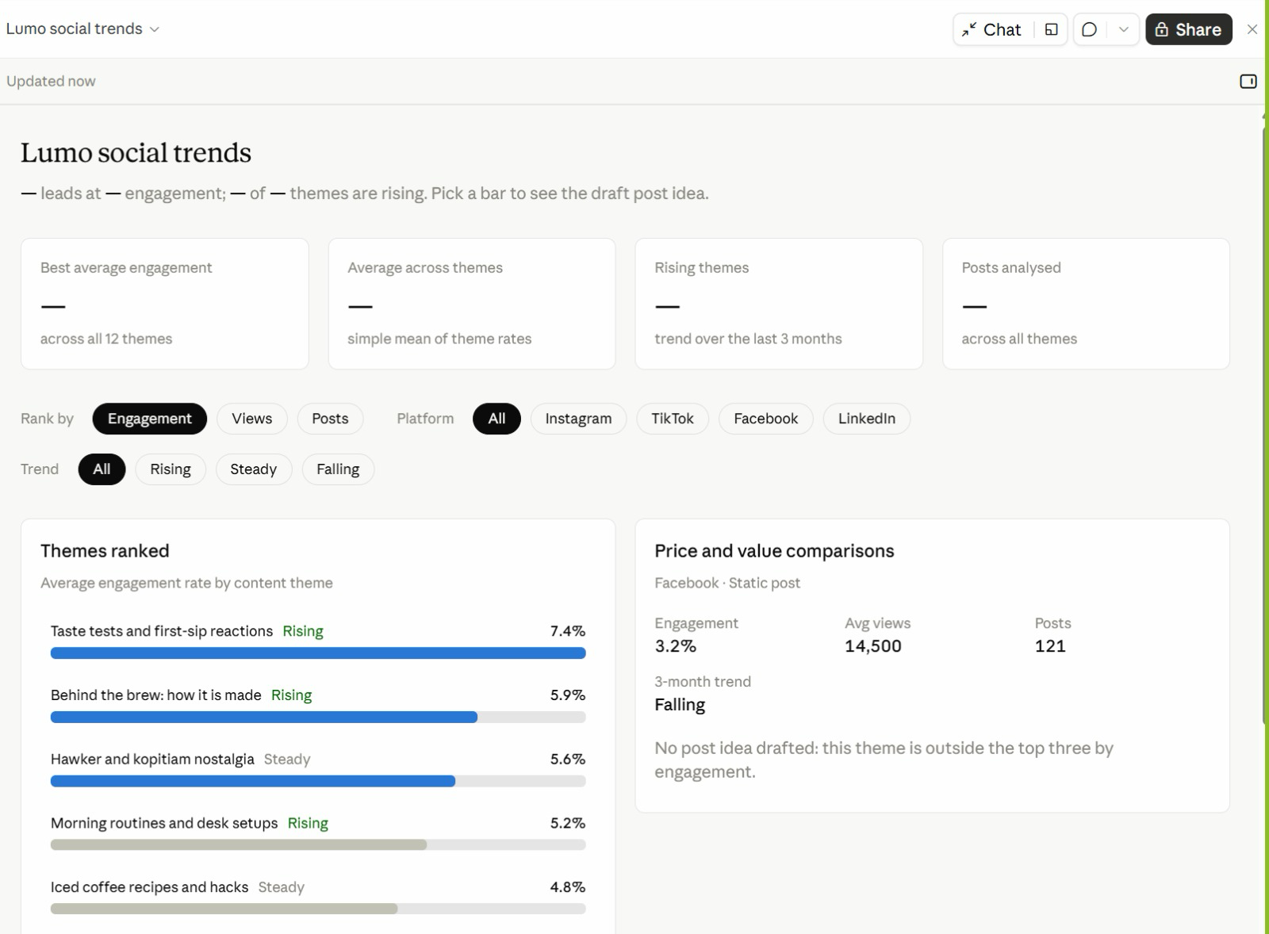
LAB 03 · FROM THE CLASS
From the Class: Lumo Social Trends
1
Filters
Rank by engagement, views or posts; filter by platform and trend.
2
Themes ranked
Taste tests and first-sip reactions lead at 7.4%, and are rising.
3
Pick a bar
The right-hand card shows that theme's numbers and a draft post idea.
4
Spot the gap
The summary cards show '—'. Ask Claude to fix them — always check the numbers.
A Live Artefact built in class from the social trends research.
© Tertiary Infotech Academy Pte Ltd
Claude AI Masterclass - Threads Edition
64

Slide 65
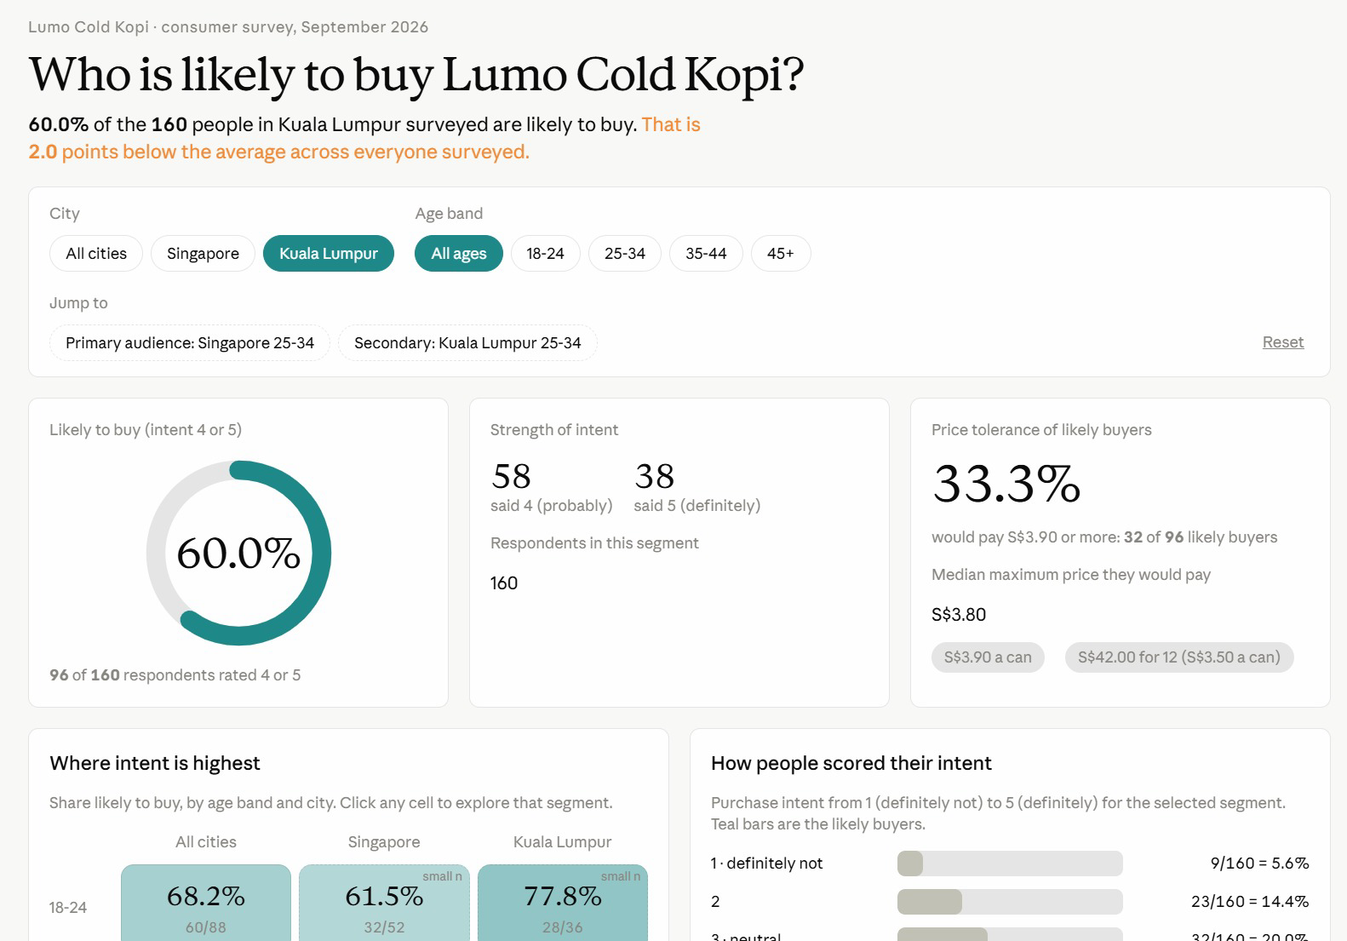
LAB 03 · FROM THE CLASS
From the Class: Who Is Likely to Buy?
1
Filters
City and age band; Jump to opens the primary and secondary audiences.
2
Headline
60.0% of 160 KL respondents are likely to buy — 2 points below the overall average.
3
Price tolerance
A third of likely buyers would pay S$3.90 or more.
4
Explore
Click any city and age cell to open that segment; small samples are flagged.
A Live Artefact on the consumer survey, filtered here to Kuala Lumpur.
© Tertiary Infotech Academy Pte Ltd
Claude AI Masterclass - Threads Edition
65

Slide 66
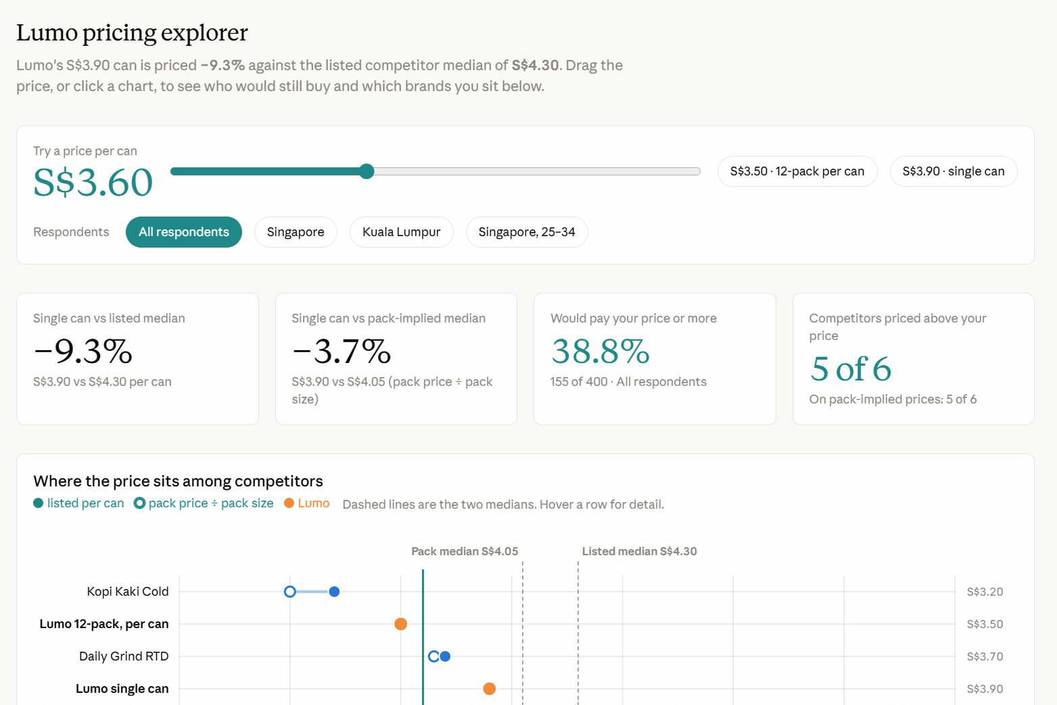
LAB 03 · FROM THE CLASS
From the Class: Lumo Pricing Explorer
1
Price slider
Drag it, or pick S$3.50 (12-pack) or S$3.90 (single can).
2
Against competitors
Lumo's S$3.90 can is 9.3% below the S$4.30 competitor median.
3
The chart
Listed and pack prices per can, with both medians as dashed lines.
Drag the price and every card recalculates who would still buy.
© Tertiary Infotech Academy Pte Ltd
Claude AI Masterclass - Threads Edition
66

Slide 67
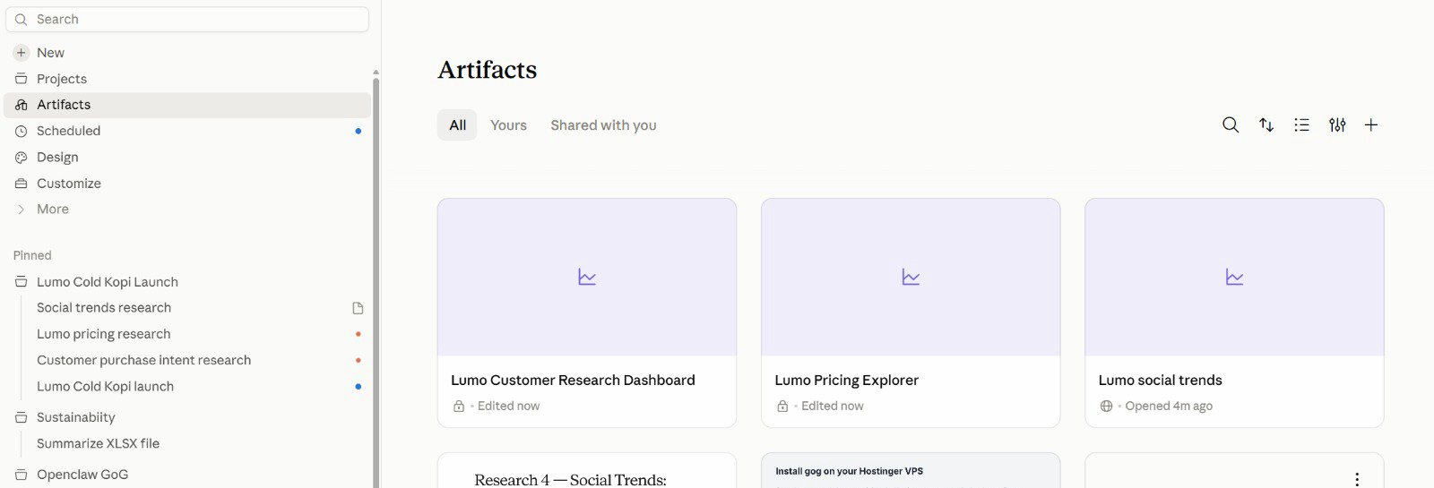
LAB 03 · FROM THE CLASS
All Your Artefacts in One Place
1
Artifacts
Open, search, sort and filter all your artefacts.
2
Lock or globe
A lock means private; a globe means shared by link.
3
Pinned
The Lumo project and its sessions stay pinned in the sidebar.
Artifacts in the sidebar lists everything you have built, across every project.
© Tertiary Infotech Academy Pte Ltd
Claude AI Masterclass - Threads Edition
67

Slide 68
TOPIC 01 · RECAP
Recap — Claude Projects and Market Research
Lab 01
You can now create a Claude Project with a goal, instructions, context and memory.
1
Lab 02
You can now hand a multi-subject research job to the lead agent and verify the merged brief.
2
Lab 03
You can now turn research data into an interactive Live Artefact dashboard and save it.
3
© Tertiary Infotech Academy Pte Ltd
Claude AI Masterclass - Threads Edition
68

Slide 69
1
Connectors: Drive and Gmail
TOPIC 02
2
Context window housekeeping
Connectors, Skills and Plugins
3
Slides, Docs and built-in skills
4
Agent Skills, plugins and mods
© Tertiary Infotech Academy Pte Ltd
Claude AI Masterclass - Threads Edition
69

Slide 70
TOPIC 2 · CONNECTORS
What Connectors Do
Connectors let Claude reach data and services that live outside the chat.
Google Drive
Search and read Sheets, Docs, Slides and PDFs; upload files; create folders; save Claude's output back to Drive.
Gmail
Search and read mail, draft messages, send / reply / forward with approval, and manage labels.
1
2
Google Calendar
View events, find availability, and create or update meetings.
Social and ads tools
Where your workspace has them, connectors for scheduling and ad platforms reach the same way — always with approval.
3
4
Approval by default
Claude asks for explicit approval before it sends, replies to or forwards an email.
Where to manage them
Individually from the + menu; account-wide under Customize → Connectors.
5
6
© Tertiary Infotech Academy Pte Ltd
Claude AI Masterclass - Threads Edition
70

Slide 71
TOPIC 2 · CONNECTORS
Turning On a Connector
1
2
3
4
5
Open the + menu
▶
Hover Connectors
▶
Toggle Drive and Gmail
▶
Grant access
▶
Name the folder
In the chat composer, click the plus sign.
The list of available connectors appears.
Switch each on and sign in to your Google account.
Approve the permissions Google asks for — including file read access.
Tell Claude which Drive folder to use for this task.
Manage them any time under Customize → Connectors.
© Tertiary Infotech Academy Pte Ltd
Claude AI Masterclass - Threads Edition
71

Slide 72
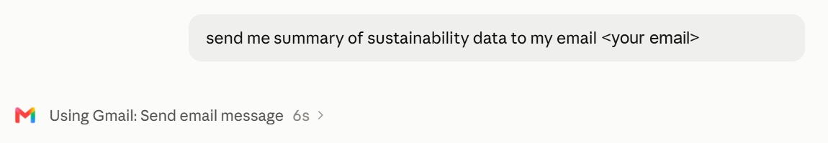
TOPIC 2 · IN THE APP
A Connector at Work: Gmail
1
Ask in plain English
Say what to send and to whom; no menus to find.
2
Watch the tool call
'Using Gmail: Send email message' names the connector and action. Click › for detail.
3
Stay in control
Ask for a draft first when the email goes to anyone but you.
One plain request — Claude chose the Gmail connector's Send email action.
© Tertiary Infotech Academy Pte Ltd
Claude AI Masterclass - Threads Edition
72

Slide 73
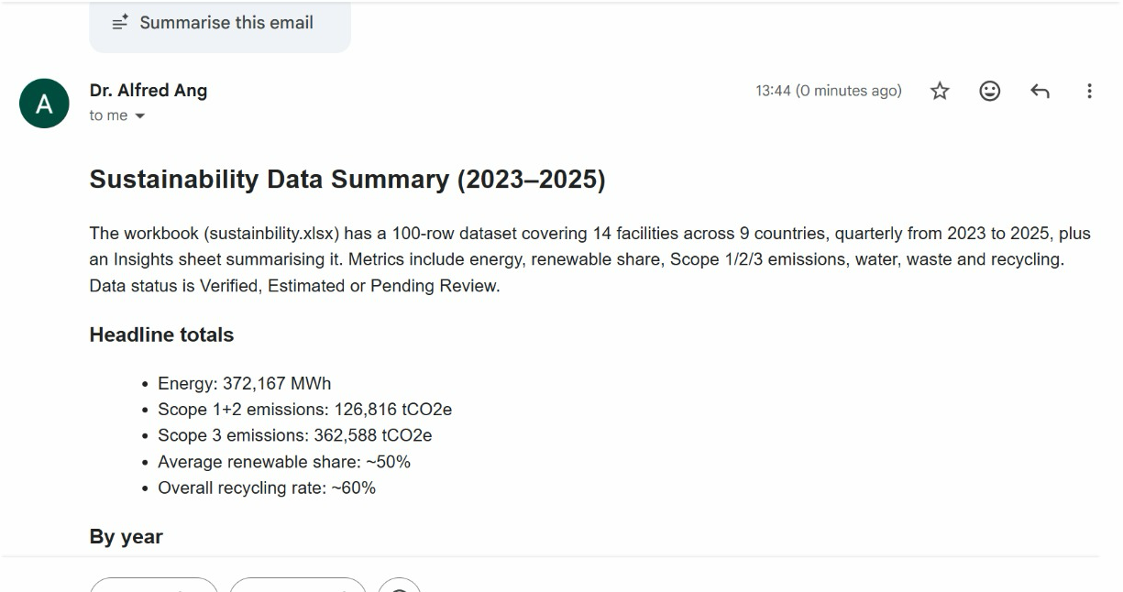
TOPIC 2 · IN THE APP
The Result in Gmail
1
Read from the file
Claude summarised the workbook: 14 facilities in 9 countries, 2023–2025.
2
Ready to read
Headings and bullets, formatted for email.
3
Verify
Spot-check one total against the source file before you forward it.
The summary arrived seconds later, written from the project's sustainability workbook.
© Tertiary Infotech Academy Pte Ltd
Claude AI Masterclass - Threads Edition
73

Slide 74
TOPIC 2 · CONTEXT
Context Window
“
The context window is all the information the model can “see” when producing a response.
”
Files, instructions, tools and skills all have to fit inside it.
© Tertiary Infotech Academy Pte Ltd
Claude AI Masterclass - Threads Edition
74

Slide 75
TOPIC 2 · CONTEXT
What Fills the Context Window
At the start of a thread.
0
1M
System
Skill definitions
Project instructions
Conversation
Tool definitions
At the start of a thread only the fixed overhead is loaded — most of the window is still free.
© Tertiary Infotech Academy Pte Ltd
Claude AI Masterclass - Threads Edition
75

Slide 76
TOPIC 2 · CONTEXT
The Same Window, Later in the Thread
After reading files, calling tools and running skills.
0
1M
System
Skill definitions
Tool call results
Project instructions
Conversation
Skills executed
Tool definitions
Files read
As the task runs, files, tool results and executed skills all accumulate. This is why a project splits big jobs into threads: each thread gets a fresh window.
© Tertiary Infotech Academy Pte Ltd
Claude AI Masterclass - Threads Edition
76

Slide 77
TOPIC 2 · CONTEXT
When the Context Window Fills Up
1. Context rot
Performance degrades. Recall of specific facts gets worse, the model starts confusing similar entities, and reasoning quality drops.
2. Tool confusion
Claude sees every tool definition. The more options competing for its attention, the more likely it picks the wrong one or fills in the wrong parameters.
3. Slower responses
The model processes every token on every turn. A bigger context means more work per message, which means longer waits before you see a reply.
4. Eats up your usage faster
Your entire context gets resent with each new message — so more tokens are burned per turn, and your limits are reached sooner.
The fix is housekeeping: one job per thread, only the connectors you need, and only the files the job actually reads.
© Tertiary Infotech Academy Pte Ltd
Claude AI Masterclass - Threads Edition
77

Slide 78
TOPIC 2 · CONTEXT
Five Levers of Context
What you actually control.
1
Conversation
Your prompt. The messages you send, including both text and attachments.
2
Project context
The files, folders and Drive folder the project reads from.
3
Connectors
The connected tools Claude can pull data from, and take actions in.
4
Skills
A set of instructions Claude follows for a repeatable workflow.
5
Instructions & memory
Project rules you wrote, and facts the project has learned.
Every lab today pulls one of these levers — context in Lab 1, connectors in Lab 4, skills in Labs 5–7, and memory in Lab 10.
© Tertiary Infotech Academy Pte Ltd
Claude AI Masterclass - Threads Edition
78

Slide 79
TOPIC 2 · CONTEXT
Check It Yourself: /context
Estimated usage by category, for a 1M-token window.
Category
Tokens
Percentage
System prompt
35.3k
3.5%
System tools
768
0.1%
MCP tools
2.6k
0.3%
MCP tools (deferred)
301.7k
30.2%
Memory files
81
0.0%
Skills
9k
0.9%
Messages
13
0.0%
Free space
650.5k
65.0%
In Claude Code, run /context to see this for your own session. Note how much a large set of connectors costs before you have typed anything — turn off the ones you do not need.
© Tertiary Infotech Academy Pte Ltd
Claude AI Masterclass - Threads Edition
79

Slide 80
TOPIC 02 · KEY CONCEPTS
Key Concepts — Connectors, Skills and Plugins
Connectors
Toggle Gmail, Drive and Calendar on from the + menu so Claude can reach data outside the chat.
Scope the folder
Point Claude at one Drive folder for the task — not your whole Drive.
1
2
Approval to send
Claude drafts, sends and replies in Gmail — sending asks for explicit approval by default.
Slides and Docs
Claude's own deck and document formats: shareable, editable, and downloadable as PowerPoint, Word or PDF.
3
4
Agent Skills
A folder of instructions Claude loads on demand, so a task runs the same way every time.
/skill-creator
Do the task once, verify the output, then let skill-creator write the SKILL.md for you.
5
6
Plugins
A bundle somebody else packaged — several skills plus the tools they need, installed in one click.
Mods
Changes to Claude's own interface or behaviour — a side panel, a status line, a slash command or a hook.
7
8
© Tertiary Infotech Academy Pte Ltd
Claude AI Masterclass - Threads Edition
80

Slide 81
LAB 04 · HANDS-ON
Connect Google Drive and Gmail
LAB 04
Objective: Connect Google Drive and Gmail, read campaign files from Drive and send an approved summary
The launch budget and timeline live in a shared Google Drive folder, not on your laptop. You upload the Lab 04 data folder to Drive, connect the Google Drive and Gmail connectors, and have the project read the budget from Drive, reconcile it against the launch brief, save the research brief back to Drive, and email you an approved summary. The budget sheet and the brief disagree on two lines — the project should catch it.
YOU'LL BUILD
Drive and Gmail connected, the research brief saved to Drive, and an approved launch summary emailed to yourself.
Tools: Claude Projects, Google Drive connector, Gmail connector
© Tertiary Infotech Academy Pte Ltd
Claude AI Masterclass - Threads Edition
81

Slide 82
LAB 04 · IN THE PROJECT
Lab 04 in the Project
What this lab sets up, uses, adds or schedules in the project.
Instructions → HOW
Uses: never send without approval — Claude drafts the email, you approve it.
Context → WHAT
Uses: the launch brief's budget, compared line by line with the Drive sheet.
1
2
Folder → WHERE
Reaches out: the Lumo Launch folder in Google Drive and your Gmail, by connector.
Scheduled → WHEN
Not used — runs when you send the prompt.
3
4
© Tertiary Infotech Academy Pte Ltd
Claude AI Masterclass - Threads Edition
82

Slide 83
LAB 04 · THE PROMPT · STEP 3
Reconcile the budget and send the summary
PROMPT — copy into Claude
Using Google Drive, open the "Lumo Launch" folder.
1. Read lumo-launch-budget.csv and lumo-launch-timeline.csv.
2. Compare the budget sheet, line by line, with the budget in
lumo-launch-brief.md from our project context. Show both in one
table and flag every line where they disagree. Do not decide
which is right.
3. Upload lumo-research-brief.docx from Lab 2 into the same Drive
folder.
4. Draft an email to <YOUR EMAIL> with the subject
"Lumo launch - research and budget check": three bullet points
from the research brief, the budget table with the disagreements
flagged, the next milestone from the timeline, and a link to the
brief in Drive.
Show me the draft. Do not send it until I approve.
NOTE Replace <YOUR EMAIL> with your own address. Send lab emails only to yourself.
© Tertiary Infotech Academy Pte Ltd
Claude AI Masterclass - Threads Edition
83

Slide 84
LAB 04 · STEPS
Connect Google Drive and Gmail
Full step-by-step, with the reasoning for each step, is in your Learner Guide.
Upload the Lab 04 data/Lumo Launch folder to your Google Drive.
Confirm Claude flagged both lines instead of choosing one.
1
5
In the project, click + → Connectors and switch on Google Drive and Gmail, signing in to Google.
Check that lumo-research-brief.docx now sits in the Lumo Launch folder in Drive.
2
6
Send the lab prompt with your own email address in place of <YOUR EMAIL>.
Read the draft email in full, then approve it.
3
7
Read the budget table Claude produces.
Open your inbox and confirm the email arrived with the Drive link working.
4
8
© Tertiary Infotech Academy Pte Ltd
Claude AI Masterclass - Threads Edition
84

Slide 85
LAB 04 · VERIFY
Connect Google Drive and Gmail
✓ Check your work
Google Drive and Gmail are connected. Claude read both CSV files from the Lumo Launch folder, showed a budget table totalling S$60,000 on both sides, and flagged Instagram (S$18,000 vs S$20,000) and Influencers (S$12,000 vs S$10,000) without choosing between them. lumo-research-brief.docx is in the Drive folder, and the approved summary email arrived in your own inbox with a working link.
© Tertiary Infotech Academy Pte Ltd
Claude AI Masterclass - Threads Edition
85

Slide 86
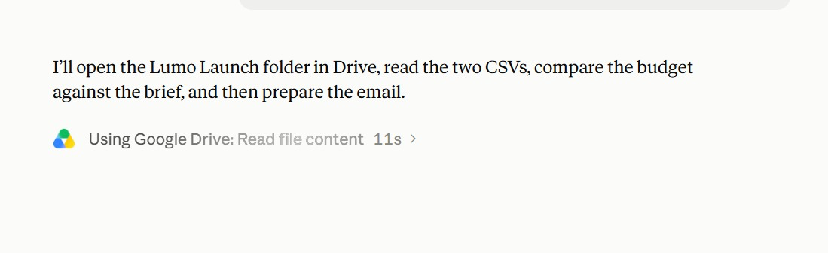
LAB 04 · FROM THE CLASS
Lab 4 in Class: Reading from Google Drive
1
Plan first
Open the Lumo Launch folder, read both CSVs, compare the budget with the brief, then email.
2
The tool call
'Using Google Drive: Read file content' — the connector at work.
3
Watch it
Each tool call shows its time; click › to see what was read.
Claude states its plan, then calls the Google Drive connector.
© Tertiary Infotech Academy Pte Ltd
Claude AI Masterclass - Threads Edition
86

Slide 87
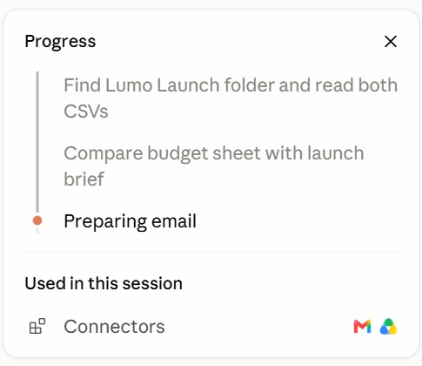
LAB 04 · FROM THE CLASS
Following the Progress Panel
1
Steps
Find the folder → compare budget and brief → prepare the email.
2
Current step
The orange dot marks the step in progress.
3
Used in this session
The connectors it called: Gmail and Google Drive.
The progress panel ticks off each step and lists what the session used.
© Tertiary Infotech Academy Pte Ltd
Claude AI Masterclass - Threads Edition
87

Slide 88
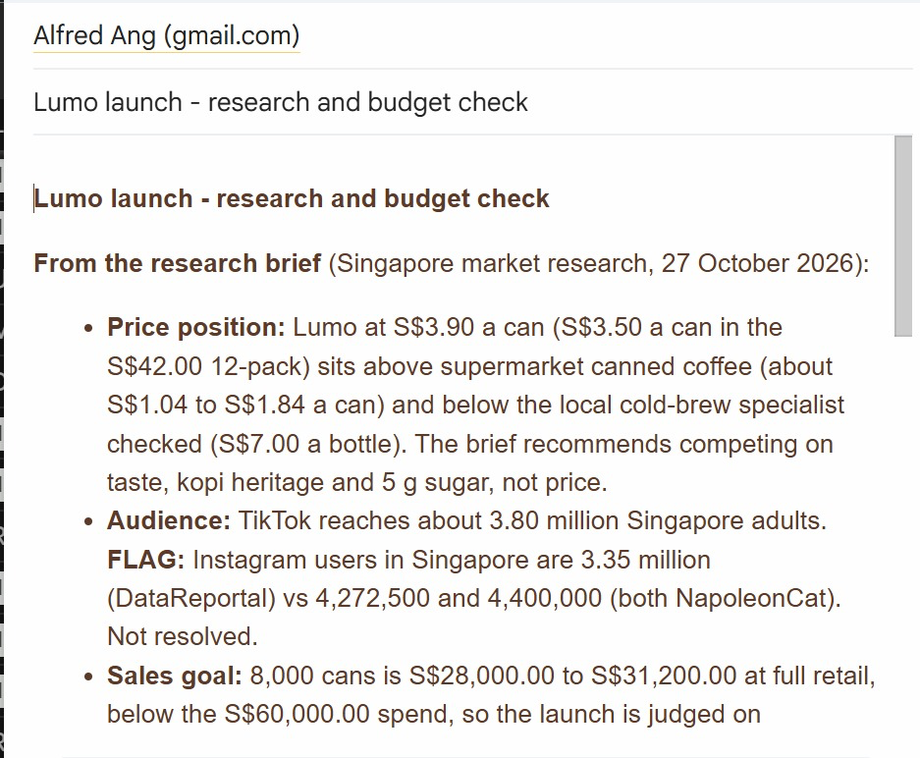
LAB 04 · FROM THE CLASS
The Lab 4 Email
1
From the brief
Price position, audience and sales goal, quoted from the research brief.
2
FLAG
Conflicting Instagram figures are flagged, not hidden — resolve each FLAG.
3
The numbers
8,000 cans is S$28,000–31,200 at retail, below the S$60,000 spend.
The research and budget check, written into Gmail from the Drive files.
© Tertiary Infotech Academy Pte Ltd
Claude AI Masterclass - Threads Edition
88

Slide 89
TOPIC 2 · SLIDES AND DOCS
Slides, Docs and Built-in Skills
Claude's own formats for the things a launch meeting needs.
Slides
A deck Claude builds and you edit in place — download as PowerPoint or PDF for the meeting.
Docs
A living document — a campaign brief, a plan — that you and Claude edit and comment on together.
1
2
Dashboards
A page of live numbers — the Live Artefact you build in Lab 3 is one.
Built-in skills
Claude's pptx, docx and xlsx skills load on their own when your request needs a file.
3
4
You never name the skill. Ask for a deck or a document; Claude picks the format and the skill that builds it.
© Tertiary Infotech Academy Pte Ltd
Claude AI Masterclass - Threads Edition
89

Slide 90
LAB 05 · HANDS-ON
Create the Launch Deck and Campaign Brief
LAB 05
Objective: Produce a launch deck in Slides and a campaign brief in Docs from the project's research
The launch team meets on Friday and needs two things: a short deck for the room and a campaign brief everyone can work from. You ask the project for both. Claude builds the deck in Slides and the brief in Docs, choosing its built-in skills on its own, using the numbers from your research and dashboard. You check every figure, then download the deck as PowerPoint.
YOU'LL BUILD
An eight-slide launch deck in Slides (downloaded as .pptx) and a campaign brief in Docs.
Tools: Claude Projects, Slides, Docs, built-in skills
© Tertiary Infotech Academy Pte Ltd
Claude AI Masterclass - Threads Edition
90

Slide 91
LAB 05 · IN THE PROJECT
Lab 05 in the Project
What this lab sets up, uses, adds or schedules in the project.
Instructions → HOW
Uses: follow the brand guidelines for anything customer-facing.
Context → WHAT
Uses: the brand kit, for the name, tagline, price and claims.
1
2
Folder → WHERE
Uses: the Lab 2 research brief; the deck downloads as .pptx.
Scheduled → WHEN
Not used — runs when you send the prompt.
3
4
© Tertiary Infotech Academy Pte Ltd
Claude AI Masterclass - Threads Edition
91

Slide 92
LAB 05 · THE PROMPT · STEP 1
Build the launch deck and campaign brief
PROMPT — copy into Claude
Using our research brief, the Market Insights dashboard and the
brand kit, create two things for Friday's launch meeting.
1. A launch deck in Slides, eight slides:
1 Title - Lumo Cold Kopi: Kopi, Chilled Right
2 The opportunity - the three survey numbers that matter most
3 Who we are for - 25-34s in Singapore, with the evidence
4 Competitors - a price ladder chart with Lumo highlighted
5 Where they find us - a discovery channel chart
6 The campaign - message, channels and dates
7 Budget - the S$60,000 split, noting the two open questions
8 Next steps and owners
Use the Lumo brand colours. Real charts, not pictures of charts.
2. A campaign brief in Docs: objective, audience, key message,
proof points, channels, budget, timeline, KPIs, and a "claims
we must not make" section.
Every number must come from the research brief or the dashboard.
List the source of each number at the end of the brief.
NOTE You do not name a skill. Ask for a deck and a document; Claude picks the format and the built-in skill.
© Tertiary Infotech Academy Pte Ltd
Claude AI Masterclass - Threads Edition
92

Slide 93
LAB 05 · STEPS
Create the Launch Deck and Campaign Brief
Full step-by-step, with the reasoning for each step, is in your Learner Guide.
In the project, send the lab prompt.
Open the campaign brief in Docs and read the "claims we must not make" section.
1
5
Open the deck when it appears and page through all eight slides.
Ask for one change to each, for example: Shorten slide 6 to three bullets.
2
6
Check slide 2 and slide 4 against your research.
Download the deck as PowerPoint and open it.
3
7
Check slide 7.
4
© Tertiary Infotech Academy Pte Ltd
Claude AI Masterclass - Threads Edition
93

Slide 94
LAB 05 · VERIFY
Create the Launch Deck and Campaign Brief
✓ Check your work
The deck has eight slides in the Lumo colours, with real charts for the price ladder and the discovery channels, the survey figures 62%, 74% and 34%, and a budget slide that shows S$60,000 with the Instagram and Influencers lines marked as open questions. The campaign brief in Docs has all nine sections, including "claims we must not make", and lists a source for every number. The deck opens in PowerPoint with its charts intact.
© Tertiary Infotech Academy Pte Ltd
Claude AI Masterclass - Threads Edition
94

Slide 95
TOPIC 2 · SKILLS
Skills Are Documented on Three Layers
Each layer reaches Claude at a different moment — which is why the description matters most.
Layers
When Claude sees them
Metadata
✓ Always in context — this is all Claude sees until the skill is triggered.
Skill name and description.
Instructions
✓ Loaded when the skill is triggered.
The step-by-step workflow, written in a SKILL.md.
Resources
✓ Loaded only when the skill needs them.
Supporting documents, templates and examples.
© Tertiary Infotech Academy Pte Ltd
Claude AI Masterclass - Threads Edition
95

Slide 96
TOPIC 2 · SKILLS
Anatomy of an Agent Skill
A skill is a folder Claude loads on demand when the task matches its description.
Metadata — name
A short identifier such as lumo-brand-voice. This is what you type to run it.
Metadata — description
What the skill does and WHEN to use it. Always in context, so this is what Claude matches against your request.
1
2
Instructions (SKILL.md)
The routine itself: tone rules, words to avoid, hashtag rules, the checks to run.
Resources
Optional examples of on-brand and off-brand posts the instructions call on.
3
4
© Tertiary Infotech Academy Pte Ltd
Claude AI Masterclass - Threads Edition
96

Slide 97
TOPIC 2 · SKILLS
Creating Your Own Skill
Do not write a skill from a blank page — do the work first, then capture it.
1
2
3
4
Do
▶
Verify
▶
Save
▶
Update
Do the task together with Claude once, step by step.
Review and refine until the output is right.
Turn it into a skill using the /skill-creator skill.
Refine it later and save over it — Claude confirms before replacing.
/skill-creator writes the SKILL.md for you, from the run you just verified.
© Tertiary Infotech Academy Pte Ltd
Claude AI Masterclass - Threads Edition
97

Slide 98
TOPIC 2 · SKILLS
A Skill vs Retyping the Request
Write the routine once, and run it by name from then on.
Pasting the brand guide each time
A brand-voice Agent Skill
• You describe the voice again in every chat.
• Easy to forget a rule when you are in a hurry.
• Each colleague words it slightly differently.
• Four channels drift into four voices.
• Nothing to hand to a new joiner or agency.
• Written once in SKILL.md and loaded by name.
• Claude applies every rule, every time.
• Every thread in the project shares it.
• Instagram and LinkedIn still sound like one brand.
• Onboarding is: copy the skill folder.
© Tertiary Infotech Academy Pte Ltd
Claude AI Masterclass - Threads Edition
98

Slide 99
TOPIC 2 · SKILLS
A Skill That Drives Your Tools
The most useful skills combine the connectors into one repeatable command.
One command
Run the whole routine by name instead of describing it again each time.
Across your tools
The skill decides which connectors to use — Drive, Gmail — and in what order.
1
2
A fixed structure
It returns the same sections every run, so you can scan it in seconds.
With checks built in
It checks claims, prices and hashtags before it hands the post back.
3
4
Still under approval
The skill drafts and reports; publishing anything still needs you.
Shared with the team
Everyone runs the same routine and gets the same format.
5
6
© Tertiary Infotech Academy Pte Ltd
Claude AI Masterclass - Threads Edition
99

Slide 100
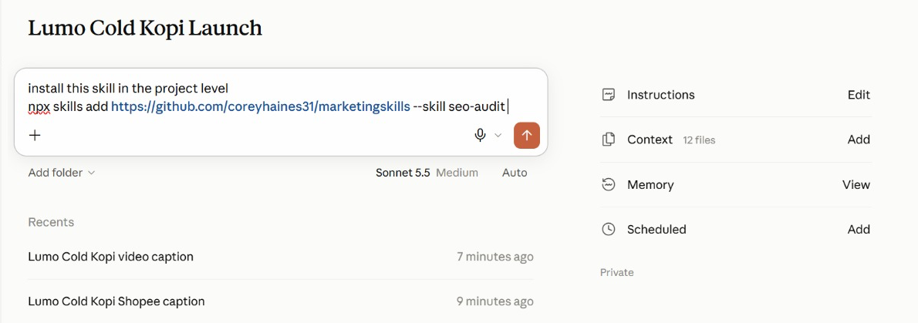
TOPIC 2 · IN THE APP
Install a Published Skill
1
The request
'Install this skill in the project level', then the npx skills add command.
2
Project level
The skill is available in this project, beside the brand-voice skill you write in Lab 6.
3
Check the source
Read a third-party skill's SKILL.md first — it runs with your access.
Ask Claude to install a skill from GitHub into the project.
© Tertiary Infotech Academy Pte Ltd
Claude AI Masterclass - Threads Edition
100

Slide 101
LAB 06 · HANDS-ON
Capture the Brand Voice as an Agent Skill
LAB 06
Objective: Rewrite content in the brand voice, verify it, and save the routine as a skill with /skill-creator
Four channels and two weeks of posts are coming, and they all have to sound like Lumo. You rewrite five off-brand captions with Claude until they are right, then use /skill-creator to turn that verified routine into a lumo-brand-voice skill. From then on, every thread in the project — and every colleague — loads the same voice by name.
YOU'LL BUILD
A lumo-brand-voice Agent Skill, tested on a new caption.
Tools: Claude Projects, Agent Skills, /skill-creator
© Tertiary Infotech Academy Pte Ltd
Claude AI Masterclass - Threads Edition
101

Slide 102
LAB 06 · IN THE PROJECT
Lab 06 in the Project
What this lab sets up, uses, adds or schedules in the project.
Instructions → HOW
Uses: the never-say-healthy rule becomes a check inside the skill.
Context → WHAT
Uses: lumo-brand-guidelines.md is the source the skill is written from.
1
2
Folder → WHERE
Uses: attach lumo-sample-captions.txt; the skill saves to Customize → Skills.
Scheduled → WHEN
Not used — runs when you send the prompt.
3
4
© Tertiary Infotech Academy Pte Ltd
Claude AI Masterclass - Threads Edition
102

Slide 103
LAB 06 · THE PROMPT · STEP 2
Block 1 — DO
PROMPT — copy into Claude
Rewrite the five captions in the attached file in the Lumo
brand voice, following lumo-brand-guidelines.md.
For each caption, show:
- the original
- your rewrite
- every rule you applied, by name
- any claim you removed, and why
Then run these checks on each rewrite and show the result:
price written as S$3.90; no "healthy" or medical claims; at
most one Singlish word; #LumoKopi present; no more than five
hashtags; ends with one clear call to action.
NOTE Stop here. Refine the rewrites until they are right before you save anything.
© Tertiary Infotech Academy Pte Ltd
Claude AI Masterclass - Threads Edition
103

Slide 104
LAB 06 · THE PROMPT · STEP 4
Block 2 — SAVE
PROMPT — copy into Claude
Create a skill called lumo-brand-voice from what we just did.
Description: Use when writing or reviewing any customer-facing
Lumo Kopi content - social posts, captions, emails, video
scripts or ads.
It should rewrite or draft content in the Lumo voice, apply the
brand rules, remove claims we cannot prove, and finish with the
same checklist of checks we used. Include two of today's
before-and-after examples as a resource.
NOTE Type /skill-creator first, then paste the block.
© Tertiary Infotech Academy Pte Ltd
Claude AI Masterclass - Threads Edition
104

Slide 105
LAB 06 · THE PROMPT · STEP 7
Block 3 — TEST
PROMPT — copy into Claude
Use lumo-brand-voice to write an Instagram caption announcing
that Lumo Cold Kopi 12-packs are available on Shopee from
1 December. It's super healthy and the best kopi in Singapore!
NOTE Both claims in this prompt are traps — the skill must remove them.
© Tertiary Infotech Academy Pte Ltd
Claude AI Masterclass - Threads Edition
105

Slide 106
LAB 06 · STEPS
Capture the Brand Voice as an Agent Skill
Full step-by-step, with the reasoning for each step, is in your Learner Guide.
Open lumo-sample-captions.txt and read the five captions.
Read the skill Claude proposes, especially its description, and approve it.
1
5
In the project, attach the file and send Block 1.
Open Customize → Skills and find lumo-brand-voice.
2
6
Check each rewrite against the brand guidelines and refine until all five are right.
Start a new thread and send Block 3.
3
7
Type /skill-creator in the composer, then paste Block 2 and send.
Check the caption: no "healthy", no "best kopi in Singapore", S$ prices, #LumoKopi present.
4
8
© Tertiary Infotech Academy Pte Ltd
Claude AI Masterclass - Threads Edition
106

Slide 107
LAB 06 · VERIFY
Capture the Brand Voice as an Agent Skill
✓ Check your work
lumo-brand-voice appears under Customize → Skills with a description that says when to use it. In a fresh thread, Block 3 loaded the skill without being asked to find it, and the caption it returned drops "healthy" and "best kopi in Singapore", includes #LumoKopi, uses at most five hashtags and ends with one call to action, followed by the checklist results.
© Tertiary Infotech Academy Pte Ltd
Claude AI Masterclass - Threads Edition
107

Slide 108
TOPIC 2 · PLUGINS
Skills vs. Plugins
Plugin
A shareable setup for Claude
Skill
Skill #2
Skill #3
How Claude
should work
How Claude
should work
How Claude
should work
Tools
Agents
Hooks
What Claude
can access
Specialist
helpers
Automated
actions
A skill is one routine. A plugin is the whole setup — install the Marketing plugin and you get every skill, command and tool it contains.
© Tertiary Infotech Academy Pte Ltd
Claude AI Masterclass - Threads Edition
108

Slide 109
TOPIC 2 · MODS
Mods: Changing Claude Itself
What a mod is
A change to Claude's own interface or behaviour, rather than to the work it does.
A panel or pane
Something that stays beside the chat and updates — a running checklist, a campaign tracker.
1
2
A status line or toast
A small always-visible signal, such as the active project or remaining usage.
A slash command
Your own /command that starts a routine you use often.
3
4
A hook
An action that runs automatically on an event — for example, before Claude sends anything.
Where to find them
Under Customize, alongside Skills, Connectors and Plugins. Ask Claude to make one for you.
5
6
© Tertiary Infotech Academy Pte Ltd
Claude AI Masterclass - Threads Edition
109

Slide 110
TOPIC 2 · PLUGINS AND MODS
Skill, Plugin or Mod?
Three ways to extend Claude — and which one you reach for.
Skill
Plugin
Mod
Changes
How a task is done
A whole toolkit
Claude's own interface
Contains
One SKILL.md + resources
Skills, tools, agents, hooks
A panel, command, hook or status line
You get it by
Writing it with /skill-creator
Installing from Discover
Asking Claude to make one
Lumo example
lumo-brand-voice
Marketing plugin
A Next Lumo post panel
© Tertiary Infotech Academy Pte Ltd
Claude AI Masterclass - Threads Edition
110

Slide 111
LAB 07 · HANDS-ON
Add the Marketing Plugin and a Mod
LAB 07
Objective: Install a plugin, use its namespaced commands alongside your own skill, and build a mod that suggests the next social post
You wrote one skill yourself; now you install a toolkit somebody else packaged. Anthropic's Marketing plugin bundles several marketing skills behind namespaced commands. You install it, use /marketing:campaign-plan to stress-test the launch plan, and run /marketing:brand-review on the deck copy — then compare a plugin with the skill you wrote. Last, you build a mod of your own: a Next Lumo post panel beside the chat that suggests what to post next.
YOU'LL BUILD
The Marketing plugin installed, a campaign plan review, a brand review of the launch copy, and a Next Lumo post mod.
Tools: Claude Projects, plugins, mods, Customize
© Tertiary Infotech Academy Pte Ltd
Claude AI Masterclass - Threads Edition
111

Slide 112
LAB 07 · IN THE PROJECT
Lab 07 in the Project
What this lab sets up, uses, adds or schedules in the project.
Instructions → HOW
Uses: plugin commands follow the same project rules.
Context → WHAT
Uses: the brand guidelines, for /marketing:brand-review.
1
2
Folder → WHERE
Uses: the research brief, campaign brief and deck; the Next Lumo post mod reads the project.
Scheduled → WHEN
Not used — the mod suggests a post; nothing runs on a timer.
3
4
© Tertiary Infotech Academy Pte Ltd
Claude AI Masterclass - Threads Edition
112

Slide 113
LAB 07 · THE PROMPT · STEP 4
Block 1 — PLAN
PROMPT — copy into Claude
/marketing:campaign-plan Review the Lumo Cold Kopi launch using
our campaign brief and research brief. Keep our objective,
audience, budget and dates. Tell me:
- what is missing from the plan,
- the three biggest risks to the 1 December launch,
- the KPIs you would track in the first two weeks, with targets.
Do not change the S$60,000 budget.
NOTE Install the plugin first: Customize → Plugins → Browse → Marketing → Install.
© Tertiary Infotech Academy Pte Ltd
Claude AI Masterclass - Threads Edition
113

Slide 114
LAB 07 · THE PROMPT · STEP 6
Block 2 — REVIEW
PROMPT — copy into Claude
/marketing:brand-review Review the copy on slides 1, 2 and 6 of
our launch deck against lumo-brand-guidelines.md. List each
change you would make and the rule behind it.
NOTE The plugin reviews; your own skill holds the house rules.
© Tertiary Infotech Academy Pte Ltd
Claude AI Masterclass - Threads Edition
114

Slide 115
LAB 07 · THE PROMPT · STEP 8
Block 3 — MOD
PROMPT — copy into Claude
Make me a mod: a panel called "Next Lumo post" that stays
beside the chat in this project.
- If social-calendar.csv is in the project, show the next post
due from today: date, platform, format, hook and call to action.
- If there is no calendar yet, suggest one next post instead:
use the top content theme in lumo-research-brief.docx and the
lumo-brand-voice skill, and say which platform and day suit it.
- Add a Refresh button and show when it last updated.
- It only suggests: never post, publish or send anything.
Tell me what the mod will do and where it will appear before
you install it.
NOTE You make a mod by asking Claude. It only suggests — nothing is posted.
© Tertiary Infotech Academy Pte Ltd
Claude AI Masterclass - Threads Edition
115

Slide 116
LAB 07 · STEPS
Add the Marketing Plugin and a Mod
Full step-by-step, with the reasoning for each step, is in your Learner Guide.
Open Customize → Plugins and browse the available plugins.
Send Block 2 to review the deck copy with /marketing:brand-review.
1
6
Find the Marketing plugin, read what it contains, and click Install.
Open Customize and look at the Mods section.
2
7
In the project composer, type /marketing and look at the commands it offers.
Send Block 3 and read what the mod will do before you let Claude install it.
3
8
Send Block 1 to stress-test the plan with /marketing:campaign-plan.
Open the Next Lumo post panel beside the chat and read its suggestion.
4
9
Read the risks and KPIs it proposes, and check the budget is unchanged at S$60,000.
5
© Tertiary Infotech Academy Pte Ltd
Claude AI Masterclass - Threads Edition
116

Slide 117
LAB 07 · VERIFY
Add the Marketing Plugin and a Mod
✓ Check your work
The Marketing plugin is installed and its /marketing: commands appear in the composer. /marketing:campaign-plan returned the gaps, three launch risks and two-week KPIs with targets while keeping the S$60,000 budget and the 1 December date. /marketing:brand-review reviewed the deck copy. You can explain the difference between lumo-brand-voice (a skill you wrote), the Marketing plugin (a packaged bundle) and a mod (a change to Claude's interface). The Next Lumo post panel sits beside the chat and suggests one on-brand post — S$ prices, no health claim — without posting anything.
© Tertiary Infotech Academy Pte Ltd
Claude AI Masterclass - Threads Edition
117

Slide 118
TOPIC 02 · RECAP
Recap — Connectors, Skills and Plugins
Lab 04
You can now connect Google Drive and Gmail, read campaign files from Drive and send an approved summary.
1
Lab 05
You can now produce a launch deck in Slides and a campaign brief in Docs from the project's research.
2
Lab 06
You can now rewrite content in the brand voice, verify it, and save the routine as a skill with /skill-creator.
3
Lab 07
You can now install a plugin, use its namespaced commands alongside your own skill, and build a mod that suggests the next social post.
4
© Tertiary Infotech Academy Pte Ltd
Claude AI Masterclass - Threads Edition
118

Slide 119
TOPIC 03
1
One thread per channel
Content Production and Scheduled Work
2
Social post specs and brand checks
3
Script, storyboard, render: the video pipeline
4
Scheduled tasks, memory and usage
© Tertiary Infotech Academy Pte Ltd
Claude AI Masterclass - Threads Edition
119

Slide 120
TOPIC 3 · CONTENT IN THREADS
One Thread per Channel
1
2
3
4
5
Brief the lead
▶
Split by channel
▶
Draft in parallel
▶
Merge the calendar
▶
Check and approve
One message: the goal, the dates, the channels and the skill to use.
The lead agent starts one thread per platform with its own spec.
Each thread drafts its posts using the brand-voice skill.
The lead agent merges the drafts into one dated calendar.
You check claims, prices and dates before anything is scheduled.
The same pattern as the Lab 2 research — one message, independent subjects — applied to production.
© Tertiary Infotech Academy Pte Ltd
Claude AI Masterclass - Threads Edition
120

Slide 121
TOPIC 3 · SOCIAL SPECS
What Each Platform Needs
Each thread gets its platform's spec as its brief.
Instagram
Carousel or Reel. Hook in the first line; caption up to 2,200 characters; 3–5 hashtags.
TikTok
9:16 video, 15–30 s. A hook in the first 2 seconds; on-screen text; one call to action.
1
2
LinkedIn
Founder or team voice; the story behind the product; no more than 3 hashtags.
Facebook
Community and offers; a clear link to buy; questions that invite comments.
3
4
Every thread loads lumo-brand-voice, so four formats still sound like one brand.
© Tertiary Infotech Academy Pte Ltd
Claude AI Masterclass - Threads Edition
121

Slide 122
TOPIC 3 · GOOD PRACTICE
Marketing Responsibly with AI
Fast production is only useful if every post is safe to publish.
Claims you can prove
“5 g sugar” is on the label. “Healthy” is a claim Lumo cannot substantiate — never use it.
Consent for email
Email only people who opted in. Lab emails go to yourself, never to real customers.
1
2
No real likenesses
Do not generate a real person, influencer or competitor logo into an ad.
Disclose partnerships
Influencer posts are labelled as paid partnerships.
3
4
A human publishes
Claude drafts and schedules drafts; a person approves every public post.
Keep the source
Keep the research files, so every number in a post can be traced back.
5
6
© Tertiary Infotech Academy Pte Ltd
Claude AI Masterclass - Threads Edition
122

Slide 123
TOPIC 03 · KEY CONCEPTS
Key Concepts — Content Production and Scheduled Work
One thread per channel
The lead agent gives Instagram, TikTok, LinkedIn and Facebook a thread each, then merges one calendar.
Skill inside a thread
Every thread loads the same brand-voice skill, so four channels still sound like one brand.
1
2
Video as code
Claude writes and runs the code that turns a storyboard and your images into an MP4.
Scheduled tasks
A prompt that runs on a timetable inside the project — daily, weekly or monthly — while you are away.
3
4
Approval stays human
A scheduled task drafts and emails the post to you. Publishing is still your click.
Usage per thread
Project settings show the tokens the lead agent and each thread used — the cost of parallel work.
5
6
© Tertiary Infotech Academy Pte Ltd
Claude AI Masterclass - Threads Edition
123

Slide 124
LAB 08 · HANDS-ON
Create and Schedule Social Posts in Parallel Threads
LAB 08
Objective: Produce a two-week, four-platform social calendar with one thread per channel, and schedule the daily post
Launch fortnight needs ten posts across Instagram, TikTok, LinkedIn and Facebook. Each platform has its own format, so you hand the job to the lead agent and let it start one thread per platform. Every thread loads lumo-brand-voice, drafts its posts to its platform's spec, and the lead agent merges them into one dated calendar. Once you have checked it, you schedule a task that emails you each day's post at 9:00am as a draft.
YOU'LL BUILD
social-calendar.csv with ten dated posts across four platforms, lumo-social-posts.docx with the full copy, and a weekday 9:00am scheduled task that emails each day's post as a draft.
Tools: Claude Projects, lead agent and threads, Agent Skills, scheduled tasks, Gmail connector
© Tertiary Infotech Academy Pte Ltd
Claude AI Masterclass - Threads Edition
124

Slide 125
LAB 08 · IN THE PROJECT
Lab 08 in the Project
What this lab sets up, uses, adds or schedules in the project.
Instructions → HOW
Uses: brand voice, S$ prices, and never publish without your approval.
Context → WHAT
Uses: the brand kit — every post is checked against its prices and claims.
1
2
Folder → WHERE
Adds: social-calendar.csv and lumo-social-posts.docx, saved in the project.
Scheduled → WHEN
NEW: Today's Lumo post, weekdays at 9:00am — emails you each day's post as a draft.
3
4
© Tertiary Infotech Academy Pte Ltd
Claude AI Masterclass - Threads Edition
125

Slide 126
LAB 08 · THE PROMPT · STEP 1
Block 1 — CREATE
PROMPT — copy into Claude
Create the launch social calendar for Lumo Cold Kopi: ten posts,
one each weekday from Tuesday 1 December to Monday 14 December
2026, using social-calendar-template.csv for the columns.
Split the drafting into four threads, one per platform, and run
them in parallel:
- Instagram: 3 posts (carousel or Reel), caption with a hook in
the first line, 3-5 hashtags.
- TikTok: 3 posts, each a 15-second video script with a hook in
the first 2 seconds and on-screen text.
- LinkedIn: 2 posts in the founder's voice, the story behind the
product, no more than 3 hashtags.
- Facebook: 2 posts for community and the 12-pack offer.
Every thread must use the lumo-brand-voice skill and our top
content theme from the research. The 1 December launch-day
post is an Instagram Reel; TikTok follows on 2 December.
Then merge the threads into social-calendar.csv (date, platform,
format, hook, copy, hashtags, visual idea, call to action) and
lumo-social-posts.docx with the full copy. Report the brand-voice
checklist result for every post, and list any post that failed.
NOTE Attach social-calendar-template.csv from the Lab 08 data folder.
© Tertiary Infotech Academy Pte Ltd
Claude AI Masterclass - Threads Edition
126

Slide 127
LAB 08 · THE PROMPT · STEP 8
Block 2 — SCHEDULE
PROMPT — copy into Claude
Schedule a recurring task in this project: "Today's Lumo post",
every weekday at 9:00am. Take today's row from
social-calendar.csv, polish it with lumo-brand-voice, check every
price and claim against the brand kit, and email it to
<YOUR EMAIL> as a draft with the subject
"Today's Lumo post - <date>". Never publish anything. If there
is no row for today, email "No Lumo post scheduled today".
Show me the task before you save it, then run it once now as a
test, using 1 December 2026 as today.
NOTE Replace <YOUR EMAIL>. The task drafts and emails — it never publishes.
© Tertiary Infotech Academy Pte Ltd
Claude AI Masterclass - Threads Edition
127

Slide 128
LAB 08 · STEPS
Create and Schedule Social Posts in Parallel Threads
Full step-by-step, with the reasoning for each step, is in your Learner Guide.
In the project, attach social-calendar-template.csv and send the lab prompt.
Open lumo-social-posts.docx and confirm the copy matches the calendar.
1
7
Watch the lead agent start the four platform threads.
Send Block 2 with your own email address in place of <YOUR EMAIL>.
2
8
Open the Instagram thread and check it loaded lumo-brand-voice.
Read the task before it is saved: name, prompt, and weekdays at 9:00am.
3
9
When the merged calendar arrives, count the rows and check the dates.
Open your inbox and read the test email for 1 December.
4
10
Read the brand-voice checklist results.
Open Scheduled in the project and confirm the task is listed. Then open the Next Lumo post panel from Lab 7 and click Refresh.
5
11
Spot-check three posts against the campaign brief's "claims we must not make".
6
© Tertiary Infotech Academy Pte Ltd
Claude AI Masterclass - Threads Edition
128

Slide 129
LAB 08 · VERIFY
Create and Schedule Social Posts in Parallel Threads
✓ Check your work
social-calendar.csv has ten rows dated on the ten weekdays from 1 to 14 December 2026 — Instagram 3, TikTok 3, LinkedIn 2, Facebook 2 — with the 1 December launch post an Instagram Reel and TikTok on 2 December. Every post passed the lumo-brand-voice checklist, none uses "healthy", every price is written S$3.90 or S$42.00, and lumo-social-posts.docx carries the same copy. Today's Lumo post is listed under Scheduled for weekdays at 9:00am; it drafts and emails only, and nothing was published.
© Tertiary Infotech Academy Pte Ltd
Claude AI Masterclass - Threads Edition
129

Slide 130
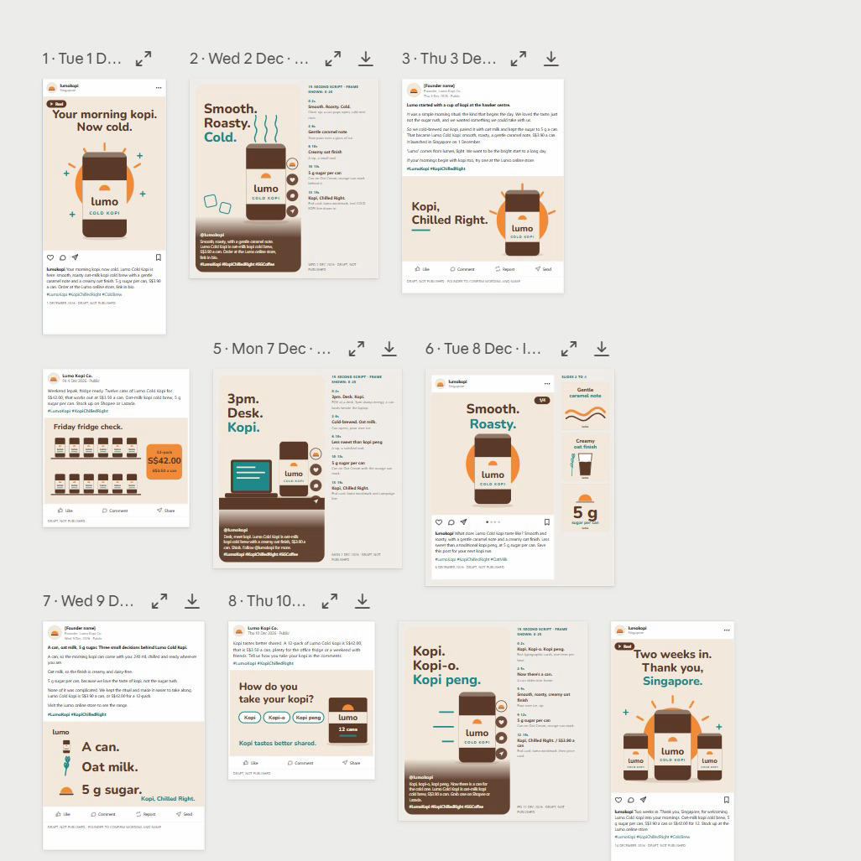
LAB 08 · FROM THE CLASS
From the Class: Two Weeks of Posts
1
One calendar
Dated posts from 1 to 14 December across the four platforms.
2
One voice
The brand-voice skill keeps every hook and caption consistent.
3
Review
Expand or download any post; each is marked DRAFT, NOT PUBLISHED.
The Lab 8 posts laid out by date — every one a draft, not published.
© Tertiary Infotech Academy Pte Ltd
Claude AI Masterclass - Threads Edition
130

Slide 131
TOPIC 3 · LAUNCH VIDEO
The Video Pipeline
1
2
3
4
5
Script
▶
Storyboard
▶
Render
▶
Check
▶
Refine
Five lines, three seconds each — hook, problem, product, proof, call to action.
One frame per line: which image, which on-screen text, which motion.
Claude writes and runs code that animates your images and text into an MP4.
Length, size 1080 × 1920, brand colours, every claim true, end card with the price.
Ask for timing or text changes in plain English and render again.
The video is code: a change is a re-render, not a re-edit.
© Tertiary Infotech Academy Pte Ltd
Claude AI Masterclass - Threads Edition
131

Slide 132
TOPIC 3 · LAUNCH VIDEO
Launch Video Specs
What the finished 15-second video must meet.
Format
Vertical 9:16, 1080 × 1920 pixels, MP4 — fits Reels, TikTok and Shorts.
Length
15 seconds: five scenes of three seconds each.
1
2
Text
Large, high-contrast captions — most people watch with the sound off.
Brand
Lumo colours and logo; the end card shows the price and the campaign hashtag.
3
4
Assets
Only the supplied product images — never a real person's likeness or a stock logo.
Fallback
No video tools in the session? Claude builds an animated HTML version to screen-record.
5
6
© Tertiary Infotech Academy Pte Ltd
Claude AI Masterclass - Threads Edition
132

Slide 133
LAB 09 · HANDS-ON
Produce a 15-Second Launch Video
LAB 09
Objective: Script, storyboard and render a vertical launch video from supplied brand assets
The TikTok and Instagram posts need a launch video. You give the project the supplied product images and logo; one thread writes a five-scene script and storyboard with lumo-brand-voice, another writes and runs the code that animates the images and captions into a 15-second, 1080 × 1920 MP4. You check it frame by frame and ask for changes in plain English.
YOU'LL BUILD
lumo-launch-15s.mp4 (1080 × 1920, 15 seconds), with its script and storyboard.
Tools: Claude Projects, threads, code execution
© Tertiary Infotech Academy Pte Ltd
Claude AI Masterclass - Threads Edition
133

Slide 134
LAB 09 · IN THE PROJECT
Lab 09 in the Project
What this lab sets up, uses, adds or schedules in the project.
Instructions → HOW
Uses: brand voice for the script; nothing is published.
Context → WHAT
Uses: the brand kit, for the tagline, price and call to action.
1
2
Folder → WHERE
Adds: attach the video assets; the script, storyboard and lumo-launch-15s.mp4 are saved.
Scheduled → WHEN
Not used — runs when you send the prompt.
3
4
© Tertiary Infotech Academy Pte Ltd
Claude AI Masterclass - Threads Edition
134

Slide 135
LAB 09 · THE PROMPT · STEP 2
Script, storyboard and render the video
PROMPT — copy into Claude
Make a 15-second vertical launch video for Lumo Cold Kopi, using
only the five images in the attached video-assets folder.
Use two threads:
Thread 1 - SCRIPT: with lumo-brand-voice, write five scenes of
three seconds each: hook, problem, product, proof, call to action.
For each scene give the image, the on-screen text (max 6 words)
and the motion. Save it as lumo-video-storyboard.md.
Thread 2 - RENDER: when the storyboard is ready, write and run
code that renders it to lumo-launch-15s.mp4: 1080 x 1920, 30 fps,
exactly 15 seconds, large high-contrast captions in the Lumo
colours, a gentle zoom on each image, and an end card with the
logo, "From S$3.90" and #KopiChilledRight.
If you cannot render video in this session, build the same thing
as an animated HTML page at 1080 x 1920 and tell me, so I can
screen-record it. Report the file's duration and size when done.
NOTE Attach the whole video-assets folder. Use only the supplied images — never a real person's likeness or another brand's logo.
© Tertiary Infotech Academy Pte Ltd
Claude AI Masterclass - Threads Edition
135

Slide 136
LAB 09 · STEPS
Produce a 15-Second Launch Video
Full step-by-step, with the reasoning for each step, is in your Learner Guide.
Open the Lab 09 data/video-assets folder and look at the five images.
Play it through, then scrub it frame by frame.
1
5
In the project, attach the folder and send the lab prompt.
Ask for one change, for example: Hold the end card for one second longer and shorten scene 2.
2
6
Read the storyboard when Thread 1 finishes.
If Claude built the HTML fallback instead, open it full screen and screen-record 15 seconds.
3
7
When the video arrives, check the reported duration and size.
4
© Tertiary Infotech Academy Pte Ltd
Claude AI Masterclass - Threads Edition
136

Slide 137
LAB 09 · VERIFY
Produce a 15-Second Launch Video
✓ Check your work
lumo-launch-15s.mp4 is 1080 × 1920, 30 fps and 15 seconds long, uses only the supplied images, shows five scenes with captions of six words or fewer in the Lumo colours, and ends on a card with the logo, "From S$3.90" and #KopiChilledRight. lumo-video-storyboard.md sits beside it and matches what plays. No scene makes a health claim.
© Tertiary Infotech Academy Pte Ltd
Claude AI Masterclass - Threads Edition
137

Slide 138
TOPIC 3 · SCHEDULED TASKS
Anatomy of a Scheduled Task
A prompt the project runs on a timetable, while you are away.
Prompt
Exactly what to do each run — written like a lab prompt, with the checks included.
Frequency
Daily, weekdays, weekly or monthly.
1
2
Time
When it runs, in your time zone — for example, weekdays at 9:00am.
Where it runs
Inside the project, so it reads the same goal, context, memory and skills.
3
4
Output
Where the result goes — an email draft, a file in Drive, a note in the project.
Approval
The step a human still takes — the task drafts, you publish.
5
6
© Tertiary Infotech Academy Pte Ltd
Claude AI Masterclass - Threads Edition
138

Slide 139
TOPIC 3 · SCHEDULED TASKS
Scheduled Tasks for a Launch
Each drafts for your approval — none publishes on its own.
Daily post, weekdays 9:00am
Take today's row from the social calendar, polish it with lumo-brand-voice and email it to me for approval.
1
Weekly report, Mondays 8:00am
Summarise last week's posts from the social calendar and anything new in the Lumo Launch Drive folder in five bullet points.
2
Monthly scan, 1st at 10:00am
Check the six competitors for new products or price changes and update the research brief.
3
A local task needs the app open. To keep tasks running with the laptop closed, give the project a cloud environment in Project settings → Environment.
© Tertiary Infotech Academy Pte Ltd
Claude AI Masterclass - Threads Edition
139

Slide 140
TOPIC 3 · SCHEDULED TASKS
Cloud Environments
Project settings → Environment: let threads and tasks run with your laptop closed.
Network access
Which websites the threads may reach — add only the ones the work needs.
1
Secrets
API keys the threads can use. Once saved, nobody can read them back — not even you.
2
Setup script
What each thread installs before it starts work, such as one package-install line.
3
© Tertiary Infotech Academy Pte Ltd
Claude AI Masterclass - Threads Edition
140

Slide 141
LAB 10 · HANDS-ON
Schedule the Weekly Report and Review the Project
LAB 10
Objective: Schedule a weekly report beside the daily post, edit project memory and review thread usage
Lab 8 scheduled the daily post. The launch also needs a report every Monday, and nobody should have to remember it. You schedule it inside the project beside the daily post, then do the housekeeping a real project needs: correct its memory when a plan changes, and read the usage of the lead agent and each thread to see what parallel work costs.
YOU'LL BUILD
A weekly-report scheduled task beside Lab 8's daily post, an updated project memory and a usage review.
Tools: Claude Projects, scheduled tasks, memory, Gmail connector
© Tertiary Infotech Academy Pte Ltd
Claude AI Masterclass - Threads Edition
141

Slide 142
LAB 10 · IN THE PROJECT
Lab 10 in the Project
What this lab sets up, uses, adds or schedules in the project.
Instructions → HOW
Reviews: which instructions are now out of date.
Context → WHAT
Reviews: which context files the launch-date change affects.
1
2
Folder → WHERE
Updates: project memory records the 8 December Singapore launch.
Scheduled → WHEN
NEW: Weekly launch report, Mondays at 8:00am — beside Lab 8's daily post.
3
4
© Tertiary Infotech Academy Pte Ltd
Claude AI Masterclass - Threads Edition
142

Slide 143
LAB 10 · THE PROMPT · STEP 1
Block 1 — SCHEDULE
PROMPT — copy into Claude
Schedule a recurring task in this project: "Weekly launch
report", Mondays at 8:00am. Summarise last week's posts from
social-calendar.csv and anything new in the Lumo Launch Drive
folder in five bullet points, and email the summary to
<YOUR EMAIL>. Draft only - do not send anything else.
Show me the task before you save it.
NOTE Replace <YOUR EMAIL>. Mondays at 8:00am, beside Lab 8's daily post.
© Tertiary Infotech Academy Pte Ltd
Claude AI Masterclass - Threads Edition
143

Slide 144
LAB 10 · THE PROMPT · STEP 4
Block 2 — MEMORY
PROMPT — copy into Claude
Remember this for the project: the Singapore launch has moved
from 1 December to 8 December 2026. Kuala Lumpur is unchanged.
Tell me everything in the project that depends on the launch
date - posts, tasks, the deck, the brief - and propose the
changes. Do not make them yet.
NOTE Then open Project settings → Memory and check what it wrote.
© Tertiary Infotech Academy Pte Ltd
Claude AI Masterclass - Threads Edition
144

Slide 145
LAB 10 · THE PROMPT · STEP 6
Block 3 — REVIEW
PROMPT — copy into Claude
Review this project for me: list the threads you started today,
what each produced, and where each output is saved. Then tell
me which context files, instructions or memory entries are now
out of date.
NOTE Then open Project settings → Usage and compare.
© Tertiary Infotech Academy Pte Ltd
Claude AI Masterclass - Threads Edition
145

Slide 146
LAB 10 · STEPS
Schedule the Weekly Report and Review the Project
Full step-by-step, with the reasoning for each step, is in your Learner Guide.
Send Block 1 with your own email address in place of <YOUR EMAIL>, and read the task before it is saved.
1
Open Scheduled in the project and confirm both tasks are listed.
2
Send Block 2, then read the list of things that depend on the date.
3
Open Project settings → Memory and find the new launch-date entry. Edit it if the wording is wrong.
4
Send Block 3 at the end of the lab.
5
Open Project settings → Usage and read the lead agent's and each thread's tokens.
6
© Tertiary Infotech Academy Pte Ltd
Claude AI Masterclass - Threads Edition
146

Slide 147
LAB 10 · VERIFY
Schedule the Weekly Report and Review the Project
✓ Check your work
Two tasks are listed under Scheduled — Today's Lumo post from Lab 8 on weekdays at 9:00am and Weekly launch report on Mondays at 8:00am — both drafting and emailing only, with nothing published. Project memory records the 8 December Singapore launch, and the lead agent listed what depends on it. Project settings → Usage shows tokens for the lead agent and for each thread you started today.
© Tertiary Infotech Academy Pte Ltd
Claude AI Masterclass - Threads Edition
147

Slide 148
TOPIC 03 · RECAP
Recap — Content Production and Scheduled Work
Lab 08
You can now produce a two-week, four-platform social calendar with one thread per channel, and schedule the daily post.
1
Lab 09
You can now script, storyboard and render a vertical launch video from supplied brand assets.
2
Lab 10
You can now schedule a weekly report beside the daily post, edit project memory and review thread usage.
3
© Tertiary Infotech Academy Pte Ltd
Claude AI Masterclass - Threads Edition
148

Slide 149
1
What you built
WRAP-UP
2
Staying in control
Summary & Next Steps
3
Next steps
4
Q&A
© Tertiary Infotech Academy Pte Ltd
Claude AI Masterclass - Threads Edition
149

Slide 150
LEARNING OUTCOMES
What You Achieved
1
Set up the Project
Set up a Claude Project with a goal, instructions, context and memory, and explain how its lead agent splits work into parallel threads.
2
Research in threads
Run multi-subject market research as parallel threads and consolidate it into one verified research brief.
3
Build a Live Artefact
Build, refine, save and download a Live Artefact dashboard from supplied research data.
4
Connect Drive and Gmail
Connect Google Drive and Gmail so Claude reads campaign files and sends an approved summary.
5
Slides and Docs
Produce a launch deck and a campaign brief with Claude's Slides and Docs, using built-in skills.
6
Skills and plugins
Capture a brand voice as an Agent Skill with /skill-creator, and install and use a marketing plugin.
7
Social posts in threads
Create a two-week, multi-platform set of social media posts in parallel threads using the brand-voice skill.
8
Make a launch video
Produce a short vertical launch video from a script, storyboard and supplied brand assets.
9
Schedule and review
Schedule recurring project tasks, maintain project memory and review thread usage, keeping a human approval step.
© Tertiary Infotech Academy Pte Ltd
Claude AI Masterclass - Threads Edition
150

Slide 151
GOOD PRACTICE
Staying in Control
Claude drafts and builds; you check and approve.
Work from mock data
Use the supplied synthetic Lumo data — never real customer records in training.
Scope the connector
Give Claude one Drive folder for the task, not your entire Drive.
Check every figure
Read the artefact's and the brief's numbers back against the source file.
Approve before sending
Read each drafted email and post in full; approve it only when the facts match.
Use a test recipient
Send class exercises to yourself, never to a real customer.
Watch thread usage
Parallel threads multiply usage — check Project settings → Usage.
© Tertiary Infotech Academy Pte Ltd
Claude AI Masterclass - Threads Edition
151

Slide 152
AFTER THE COURSE
Next Steps
Start one real Project
Give your next campaign a project with a goal, instructions and context.
Split one job into threads
Next time you research competitors, give each one its own thread.
1
2
Capture your brand voice
Turn your real brand guide into a skill your whole team shares.
Schedule one routine
Pick the post or report you produce every week and schedule the draft.
3
4
Browse Discover
See which plugins already exist before you write a skill someone has packaged.
5
© Tertiary Infotech Academy Pte Ltd
Claude AI Masterclass - Threads Edition
152

Slide 153
THANK YOU FOR ATTENDING
Your launch project is ready
A Claude Project with a lead agent and threads, verified market research, a Live Artefact dashboard, a deck and brief, a brand-voice skill, two weeks of social posts, a launch video and the scheduled tasks that keep it all moving.
© Tertiary Infotech Academy Pte Ltd
Claude AI Masterclass - Threads Edition
153

